Slide 1
Mathematical Methods of Uncertainty Quantification in Hydrology
Assignment 1,2 & 3: Parameter Optimization, Local Sensitivity Analysis & Global Sensitivity Analysis
Group 1: Adrien Thébault, Vincent Taneli Olander, Nafisa Raihana

Slide 2
Assignment 1: Parameter Optimization

Slide 3
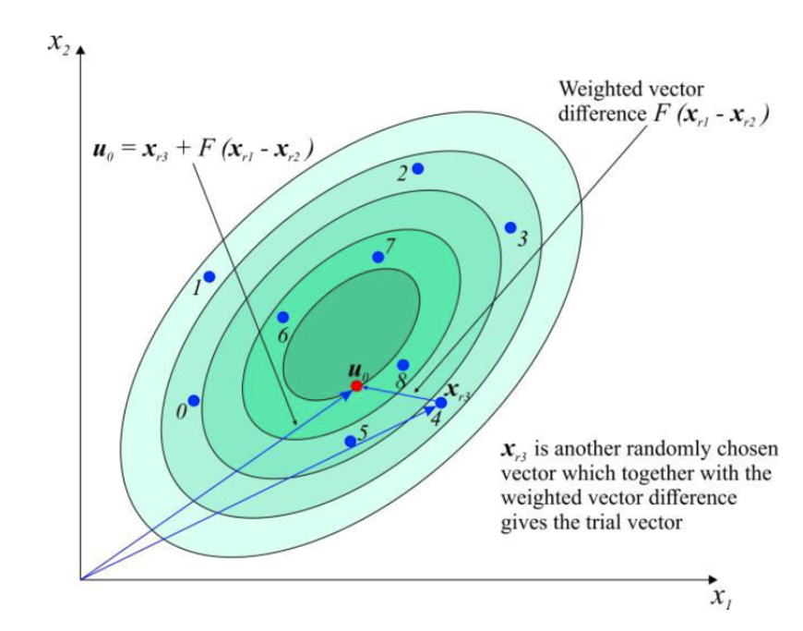
Assignment 1: Parameter Optimization
Preconsiderations
Understanding the model and the optimization method
18 parameters which are free to chose in given bounds
4 main modules in the HBV001a model
Catchment: Bavaria, short time series
Differential Evolution
Gradient Based Optimizer

Slide 4
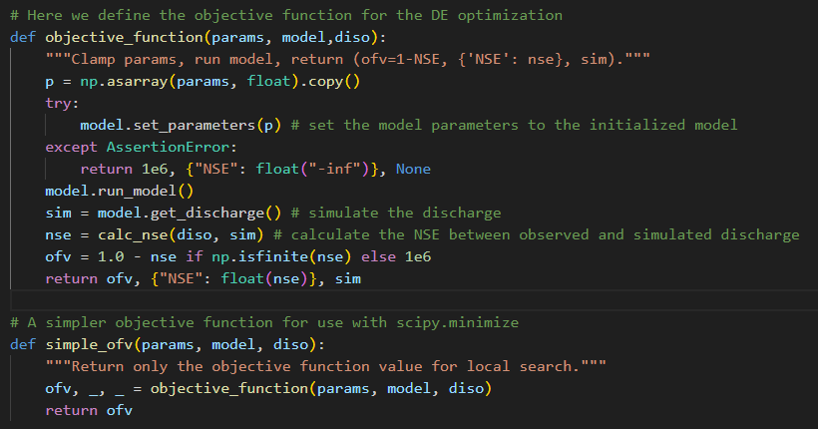
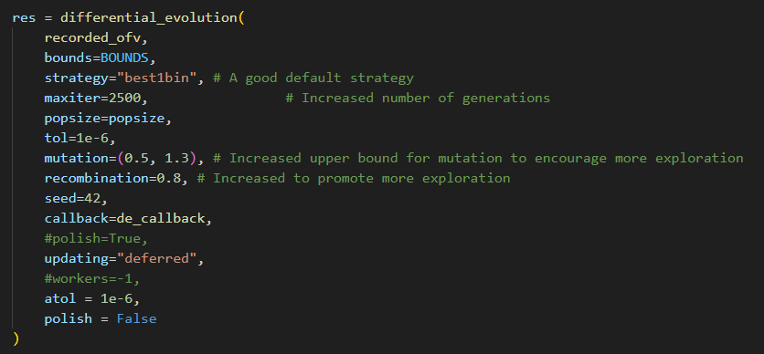
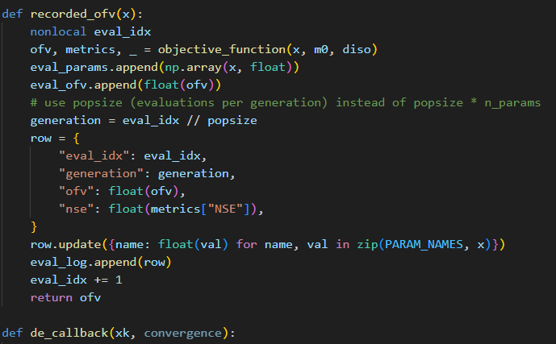
Assignment 1: Parameter Optimization
Original Code – The Differential Evolution

Slide 5
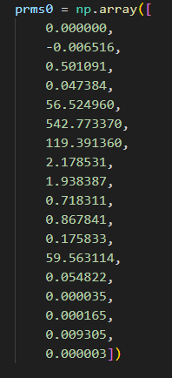
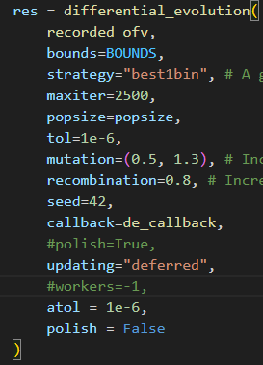
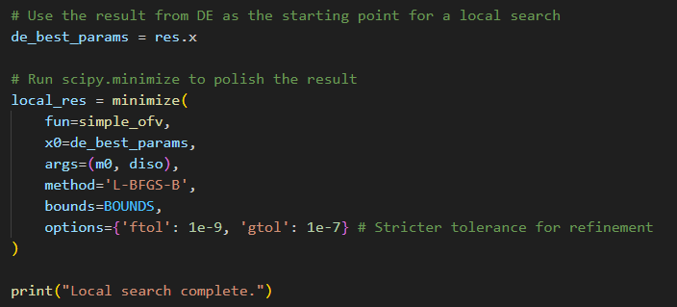
Assignment 1: Parameter Optimization
Original Code – Tuning The Optimization

Slide 6
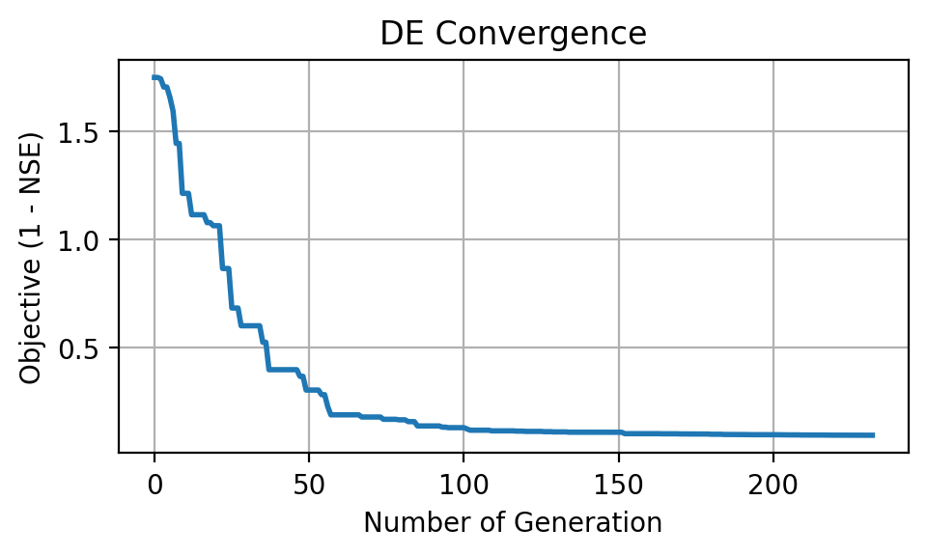
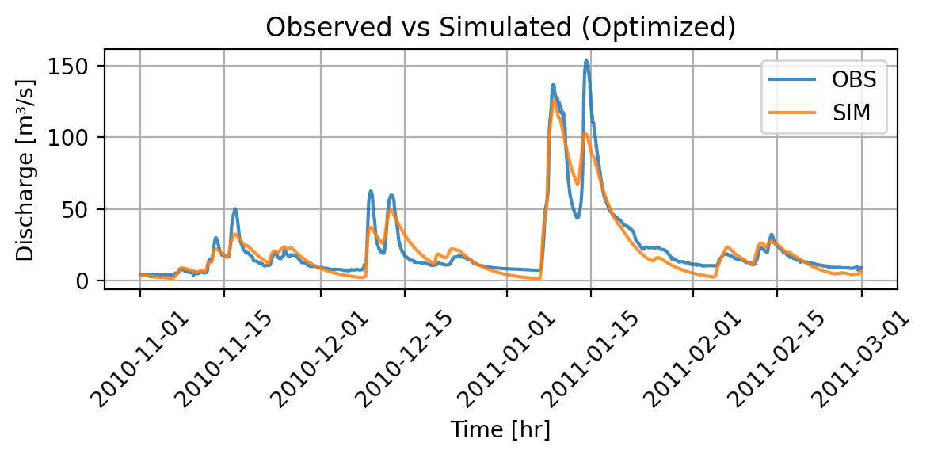
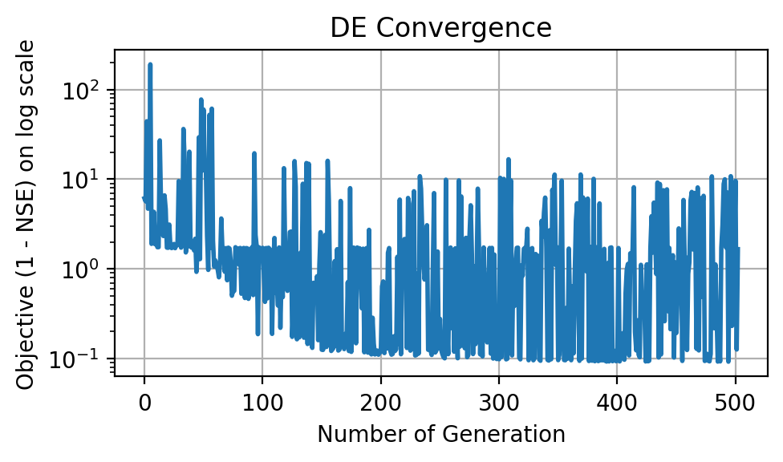
Assignment 1: Parameter Optimization
Overall Result
NSE: 0.901
Stabilizing: ~ 100 Iterations

Slide 7
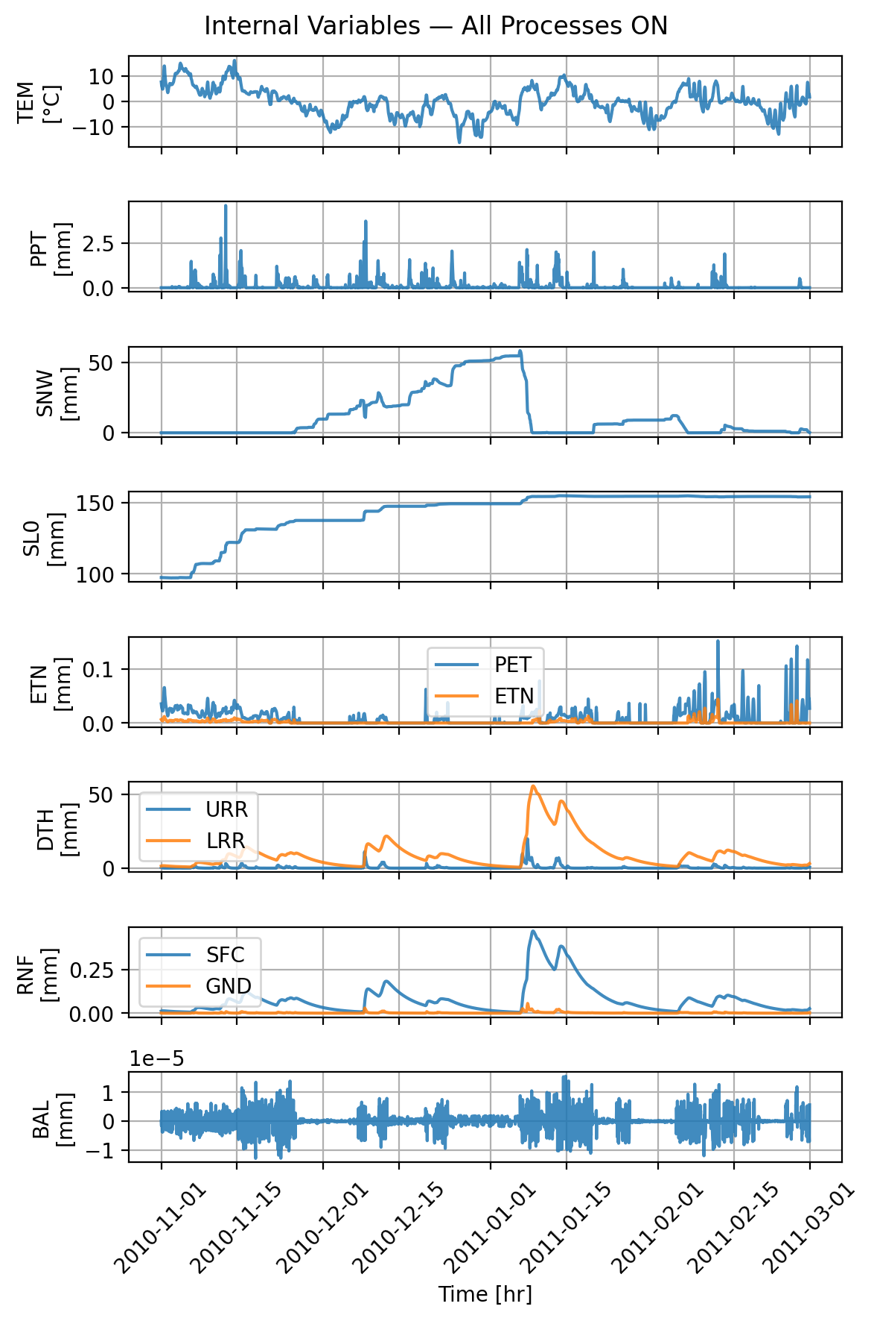
Assignment 1: Parameter Optimization
Detailed Parameters and internal variables
Snow initial depth: 0.000000
Snow fall/melt temperature: 0.148940
Snow melt air factor: 0.634415
Precipitation melt air factor: 0.036731
Soil initial moisture: 94.568525
Soil permanent wilting point: 432.979200
Soil field capacity: 148.866130
Soil beta: 2.659653
Storage initial upper reservoir: 1.728010
Storage initial lower reservoir: 0.739939
Upper-res. runoff split ratio: 0.748241
Percolation coefficient upper-to-lower: 0.185272
Upper-res. threshold depth: 60.579322
Upper-res. threshold coefficient: 0.143289
Upper-res. discharge to runoff coefficient: 0.000401
Upper-res. Runoff coefficient: 0.000147
Discharge rate: 0.008535
Lower-res. runoff coefficient: 0.000024

Slide 8
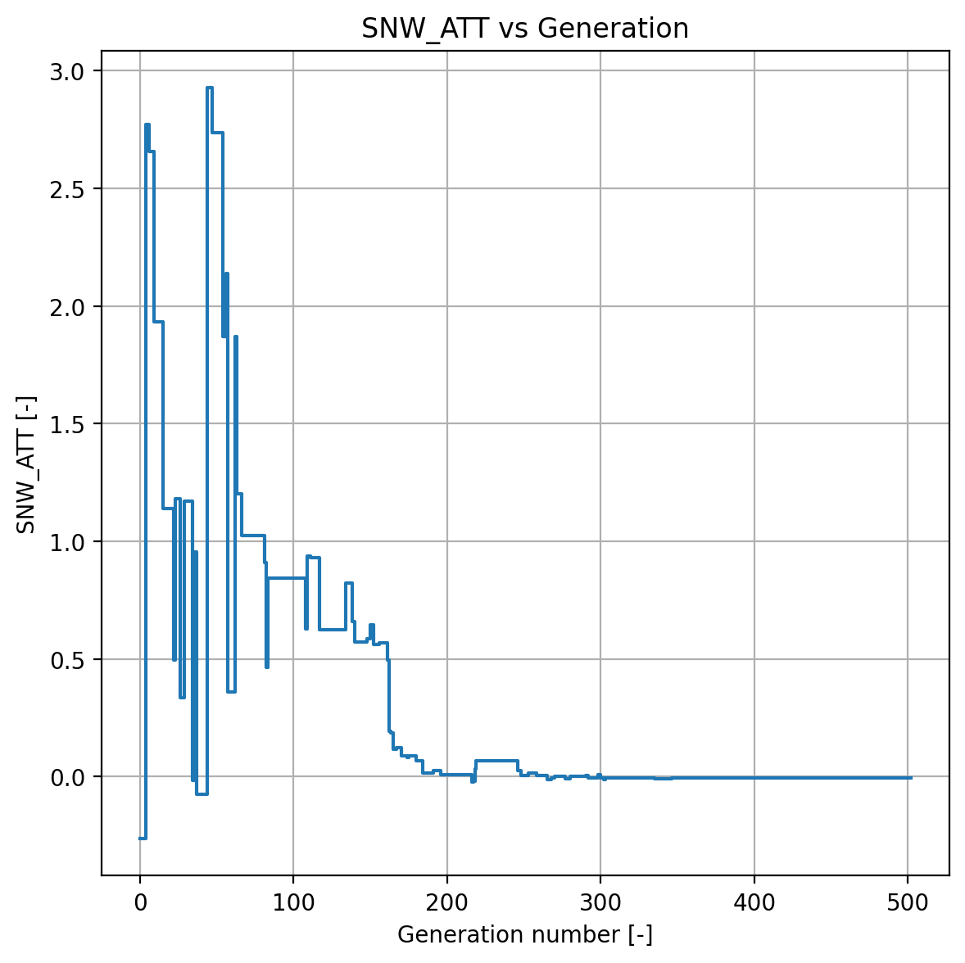
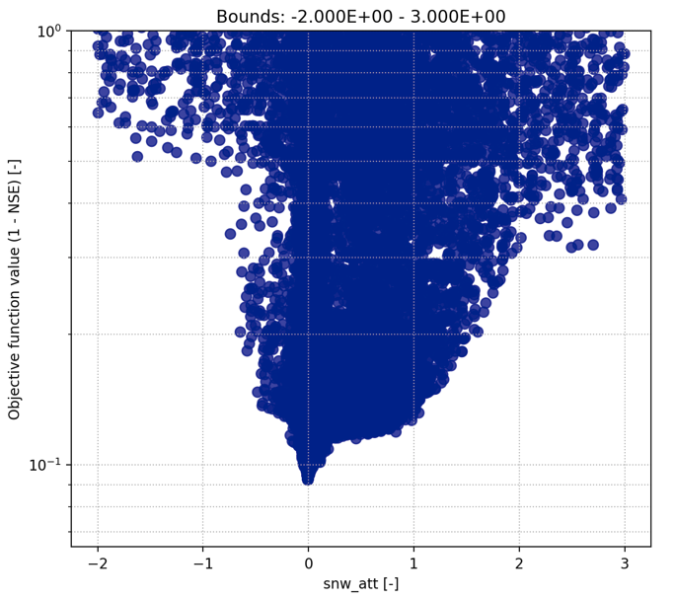

Assignment 1: Parameter Optimization
Snow Module – SNW_ATT
The Threshold Temperature turns the snow module on and off, i.e. it controls if melt occurs or not
Convergence Plot
Scatter Plot

Slide 9
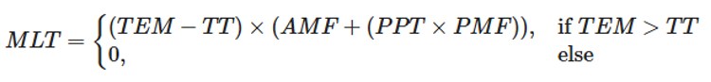
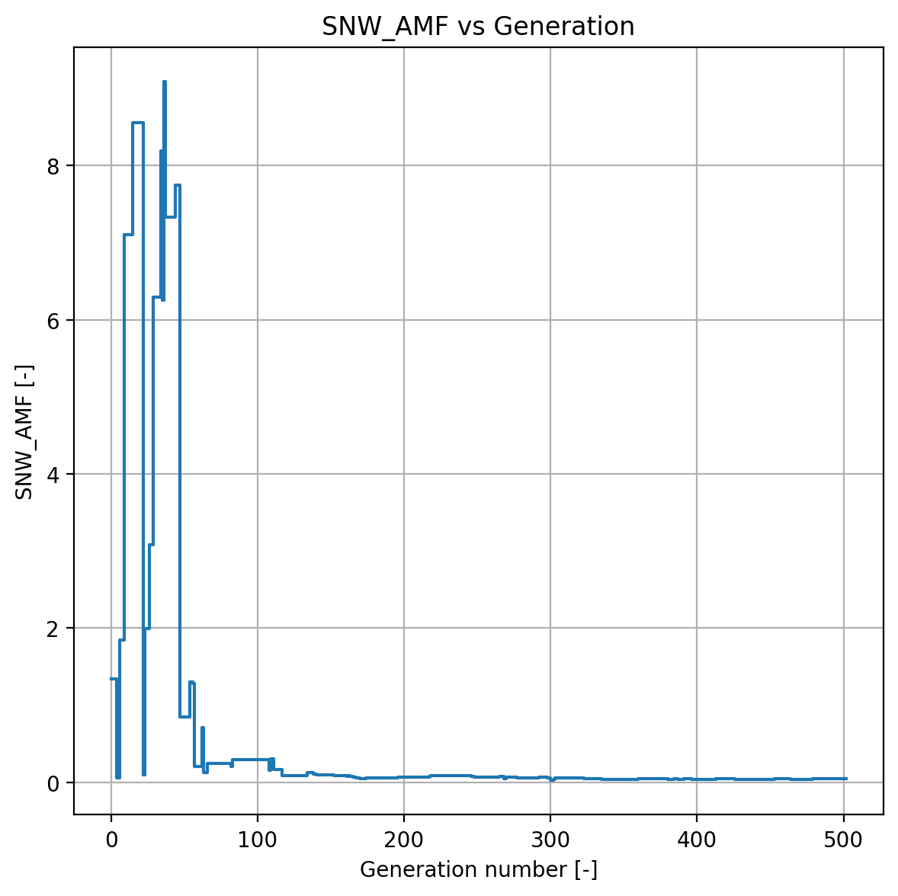
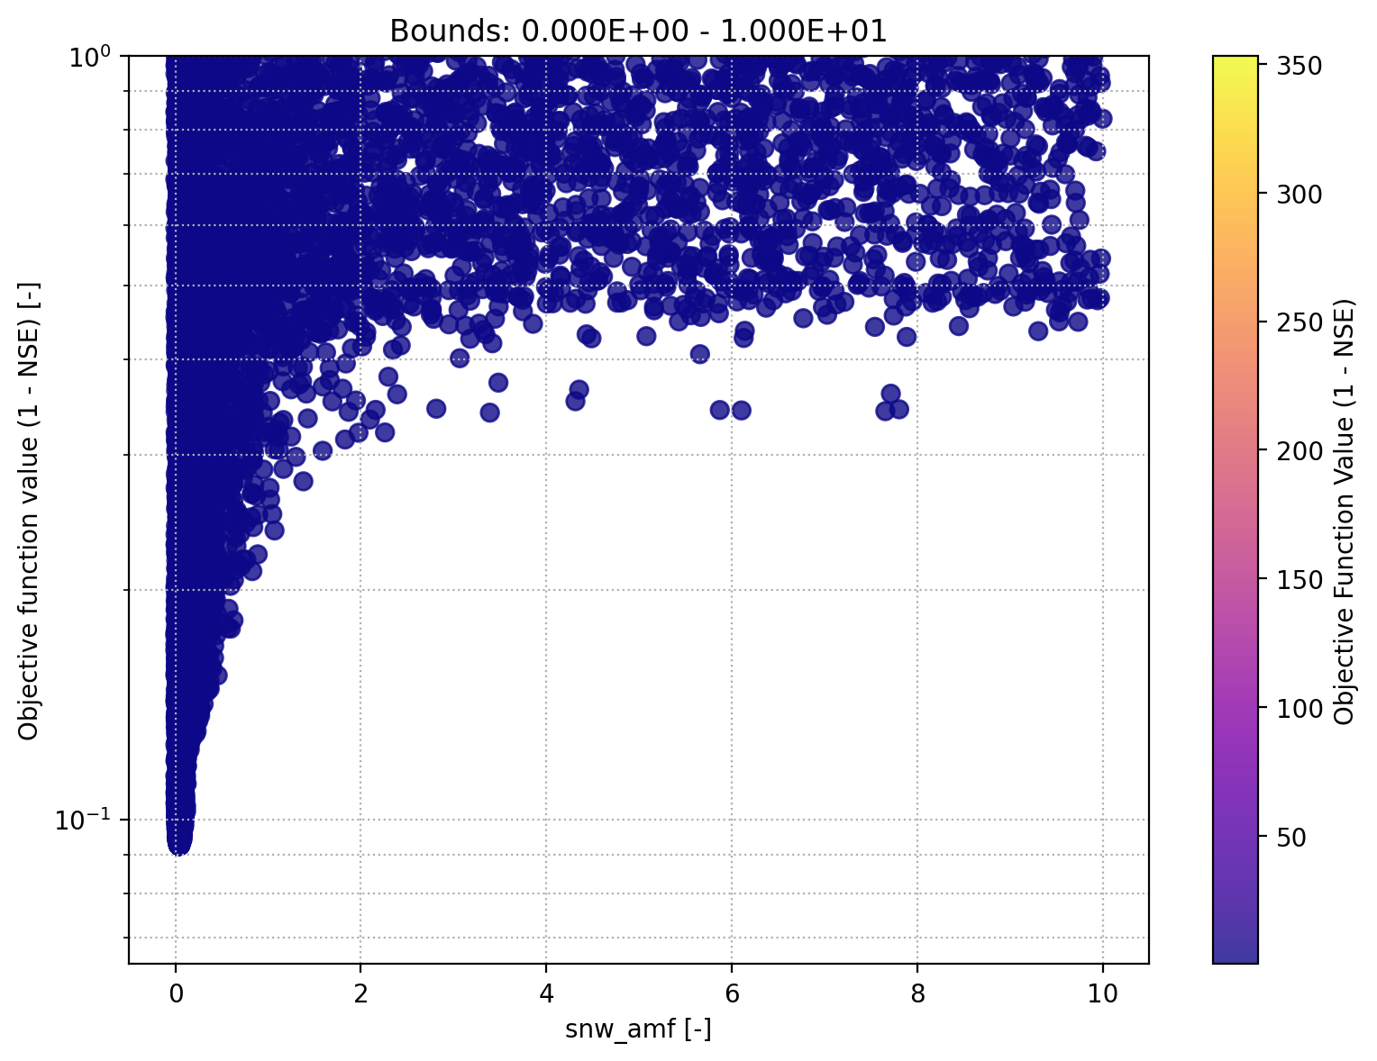
Assignment 1: Parameter Optimization
Snow Module – SNW_AMF
The Air Temperature Melt factor (AMF) contributes to melt
Convergence Plot
Scatter Plot

Slide 10
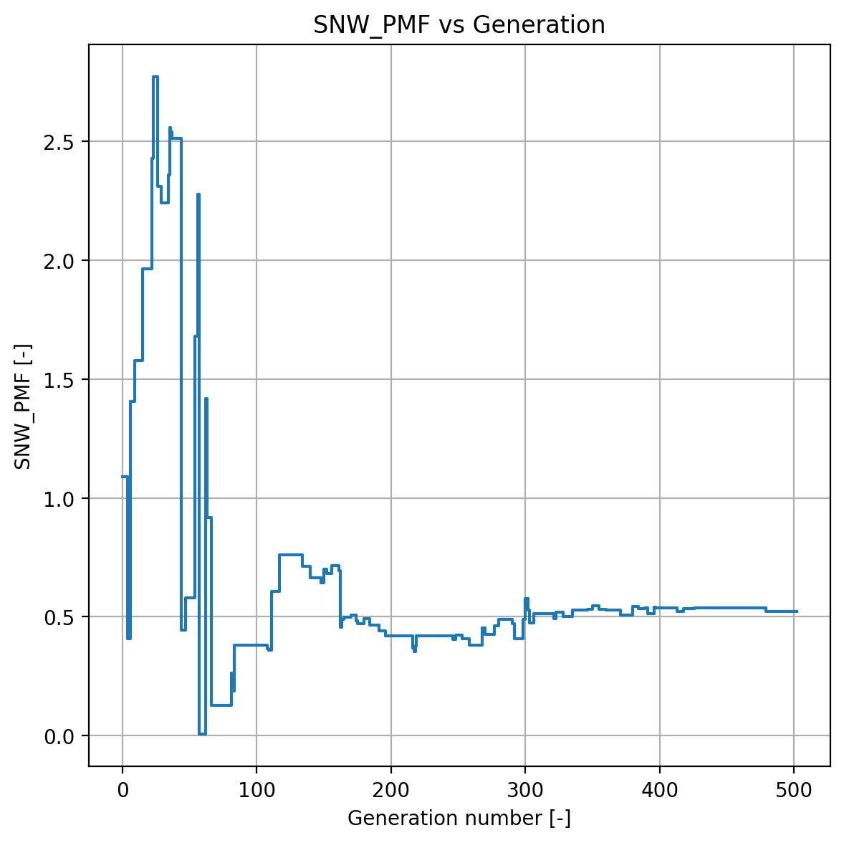
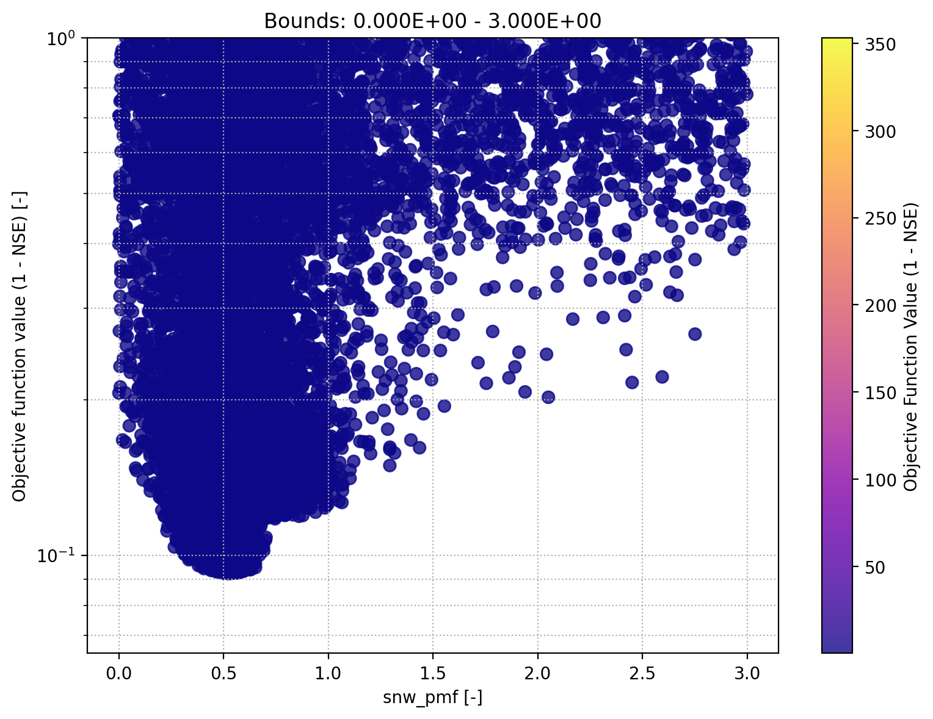
Assignment 1: Parameter Optimization
Snow Module – SNW_PMF
The Precipitation Melt Air Factor (PMF) contributes to melt
Convergence Plot
Scatter Plot

Slide 11
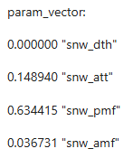
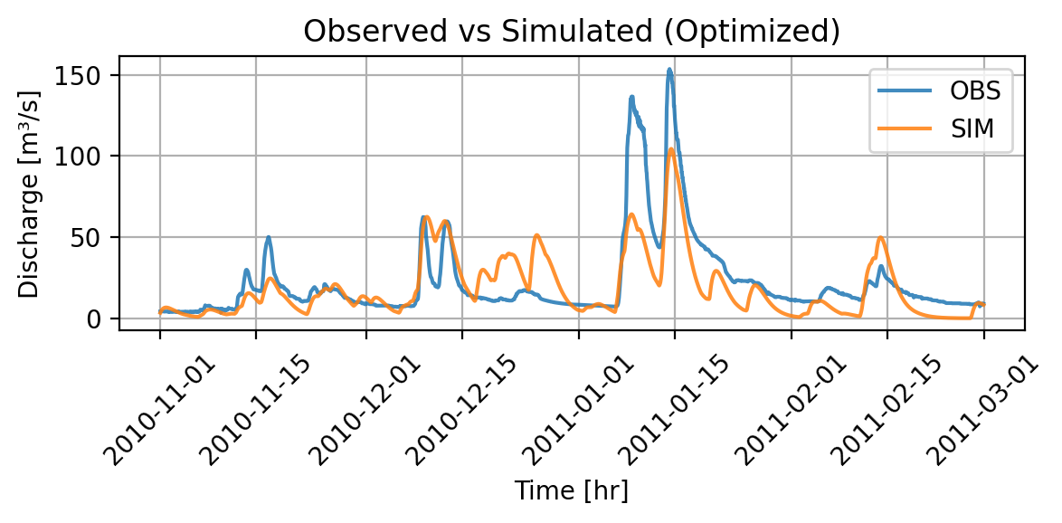

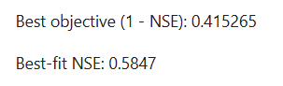
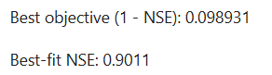
Assignment 1: Parameter Optimization
Snow Module Off – Optimization Part 1
We set TT = -100°C
We set AMF = PMF = 0
Adapt bounds and run optimization
Simulated Discharge – snow modul off
Simulated Discharge – all modules on

Slide 12
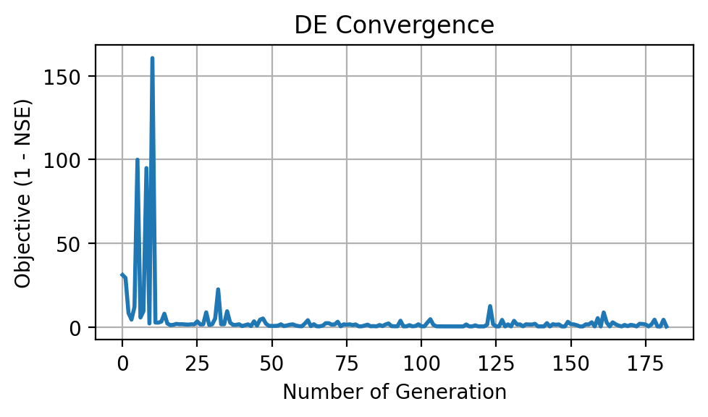
Assignment 1: Parameter Optimization
Snow Module Off – Optimization Part 2
Schenkenau in Bavaria -> We expect melt
Less peaky as melt implies higher runoff
Interesting behavior (snow then no snow at fast melt)
High OFV
Poor convergence
Conclusion: Snow module relevant

Slide 13
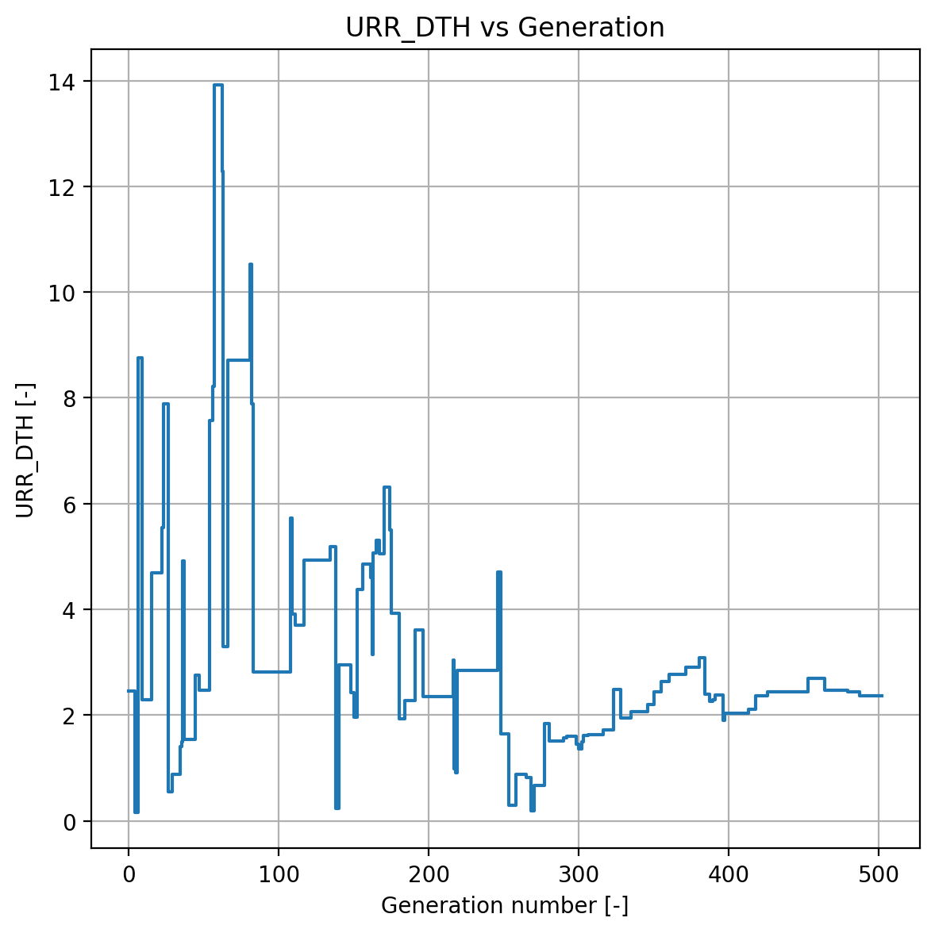
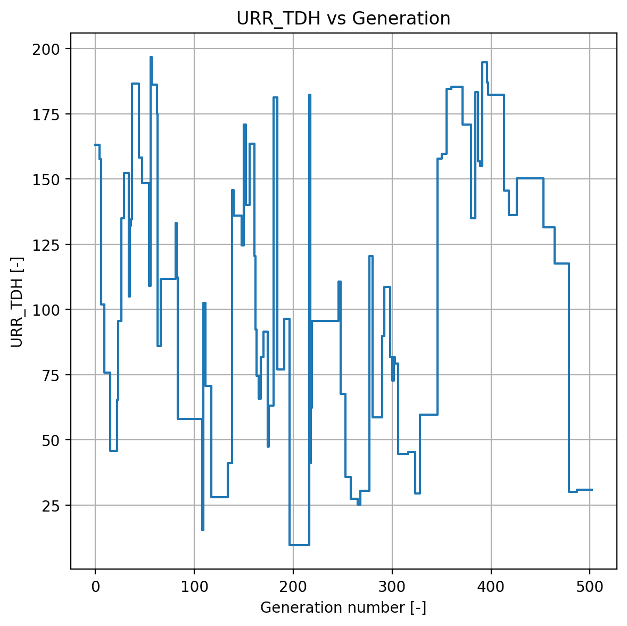
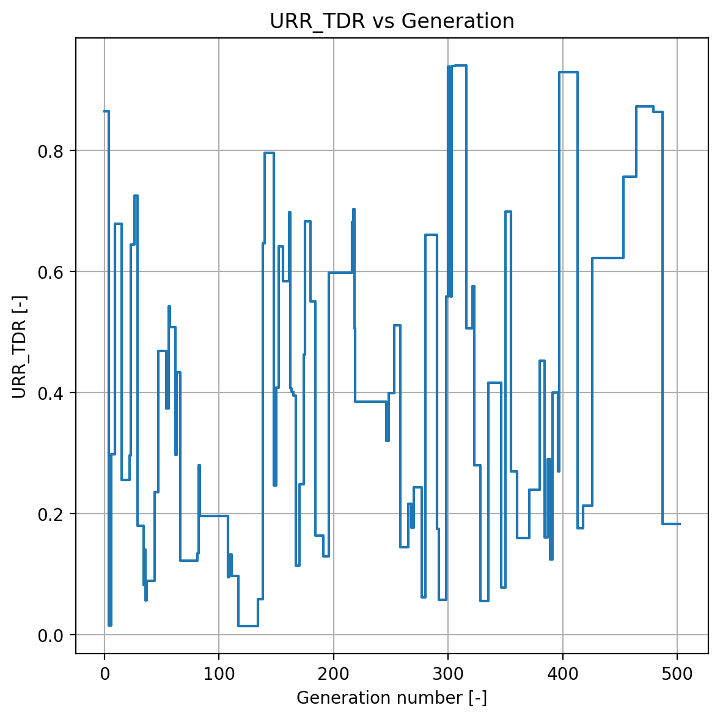
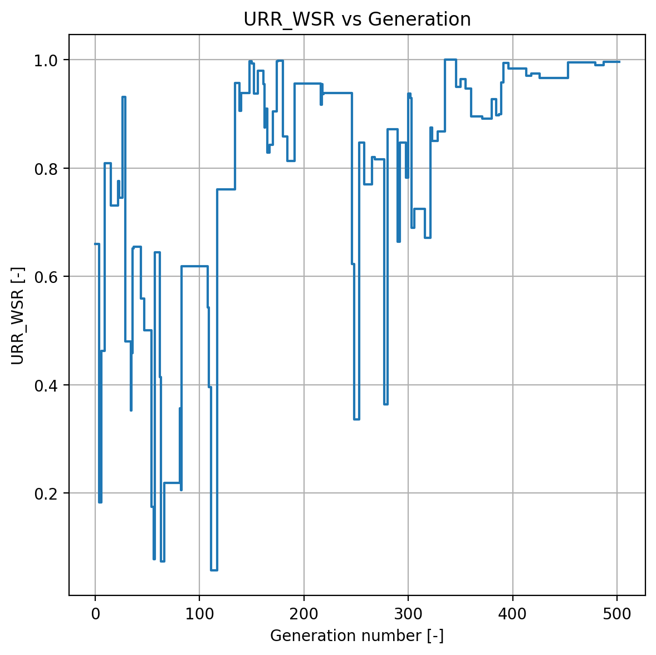
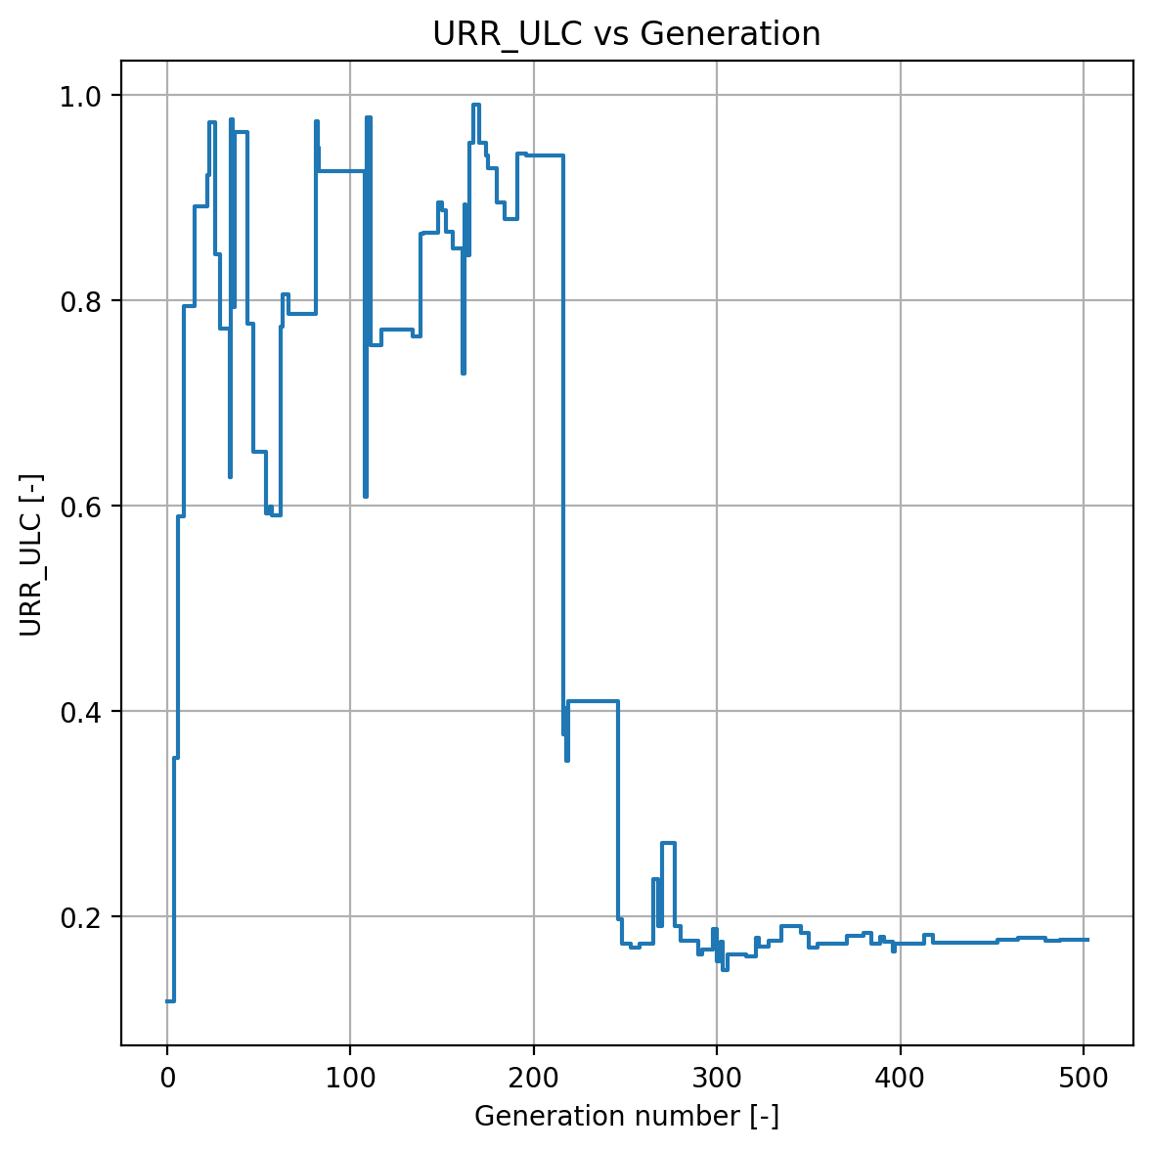
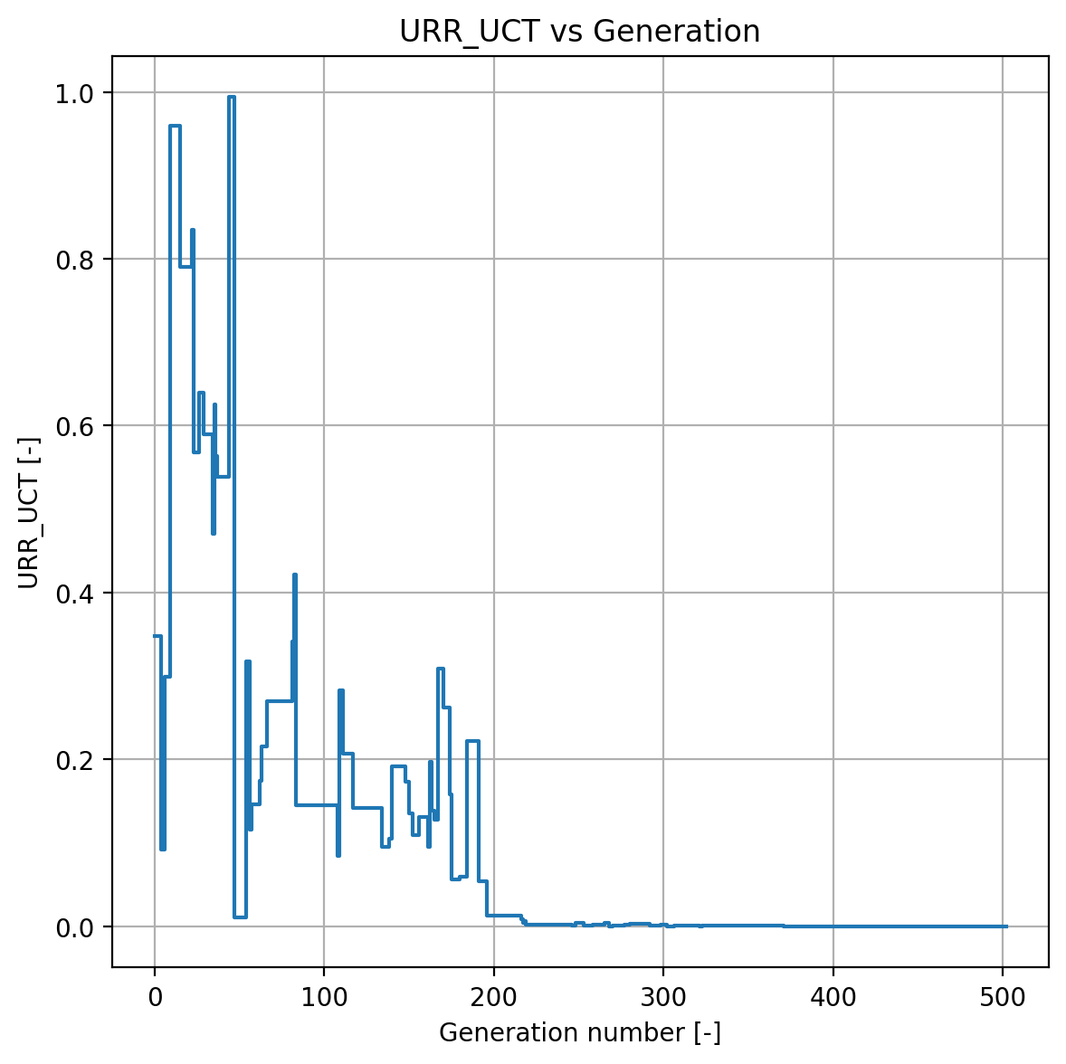
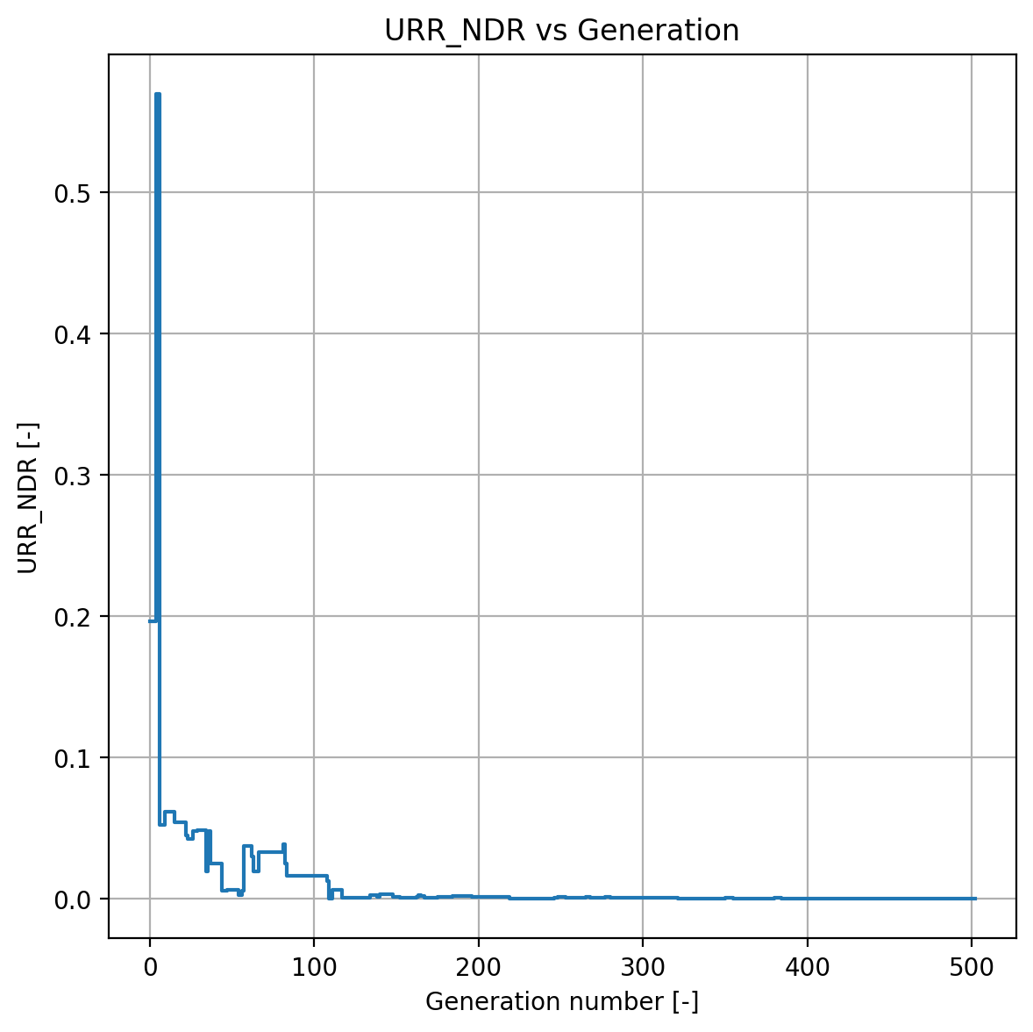
Assignment 1: Parameter Optimization
Upper Reservoir Module – All parameters
The URR controls the fast flow only if the threshold depth is attained

Slide 14
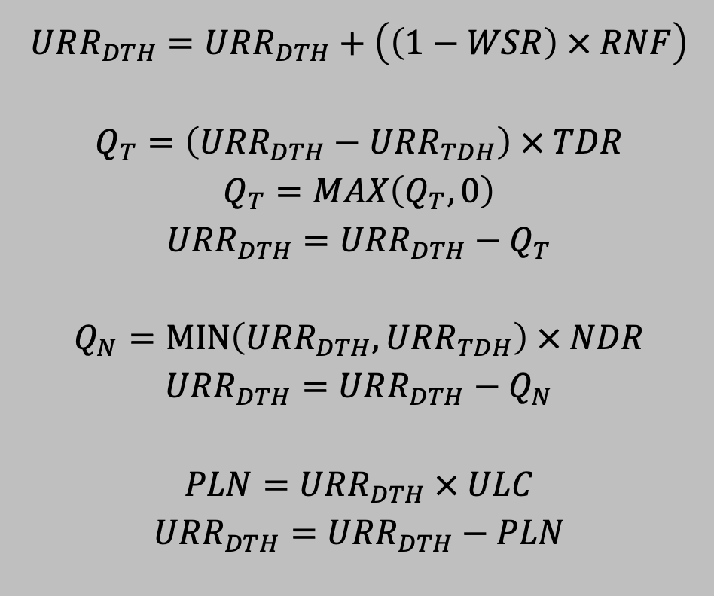
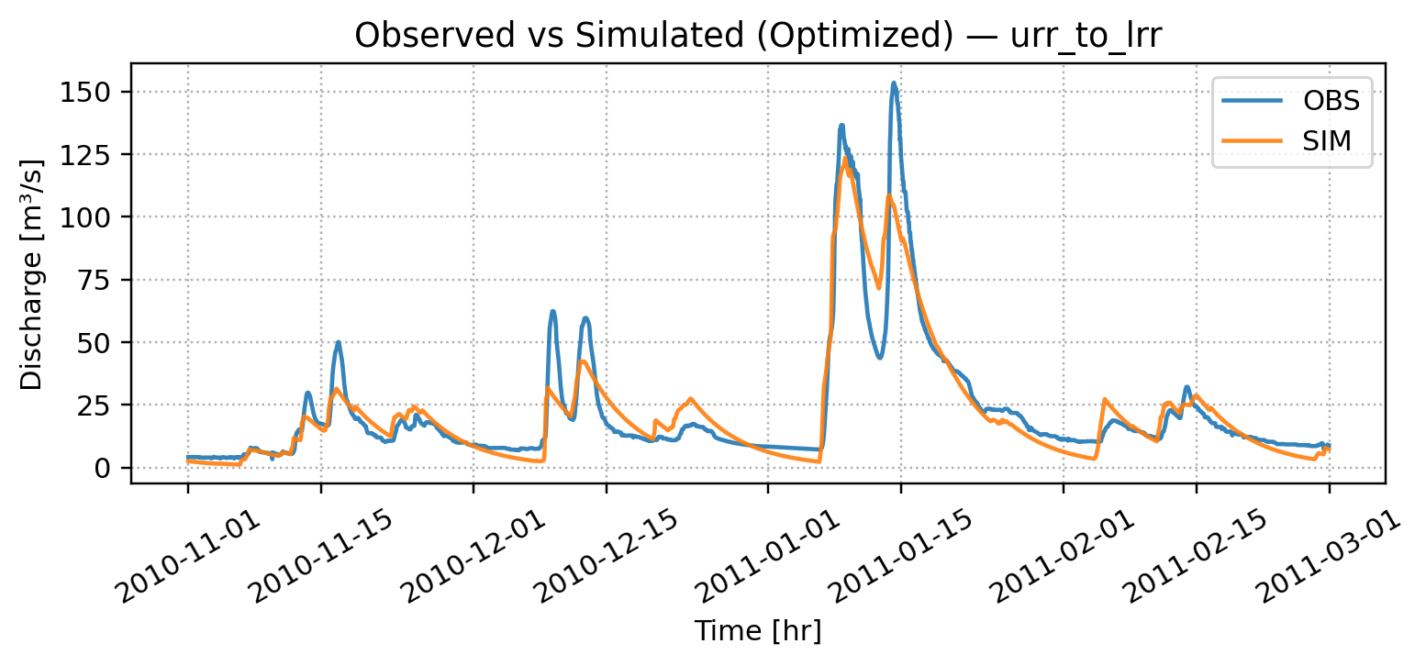
Assignment 1: Parameter Optimization
Turning URR Module (fast surface flow) off
WSR = 0
URR_TDH​ = very large (≈1000)
TDR=0, NDR=0
ULC=1
Result:
PLN=RNF,Q_T=0,Q_N=0
URR acts as a pass-through to LRR, with no direct quickflow.
NSE = 0.8874

Slide 15
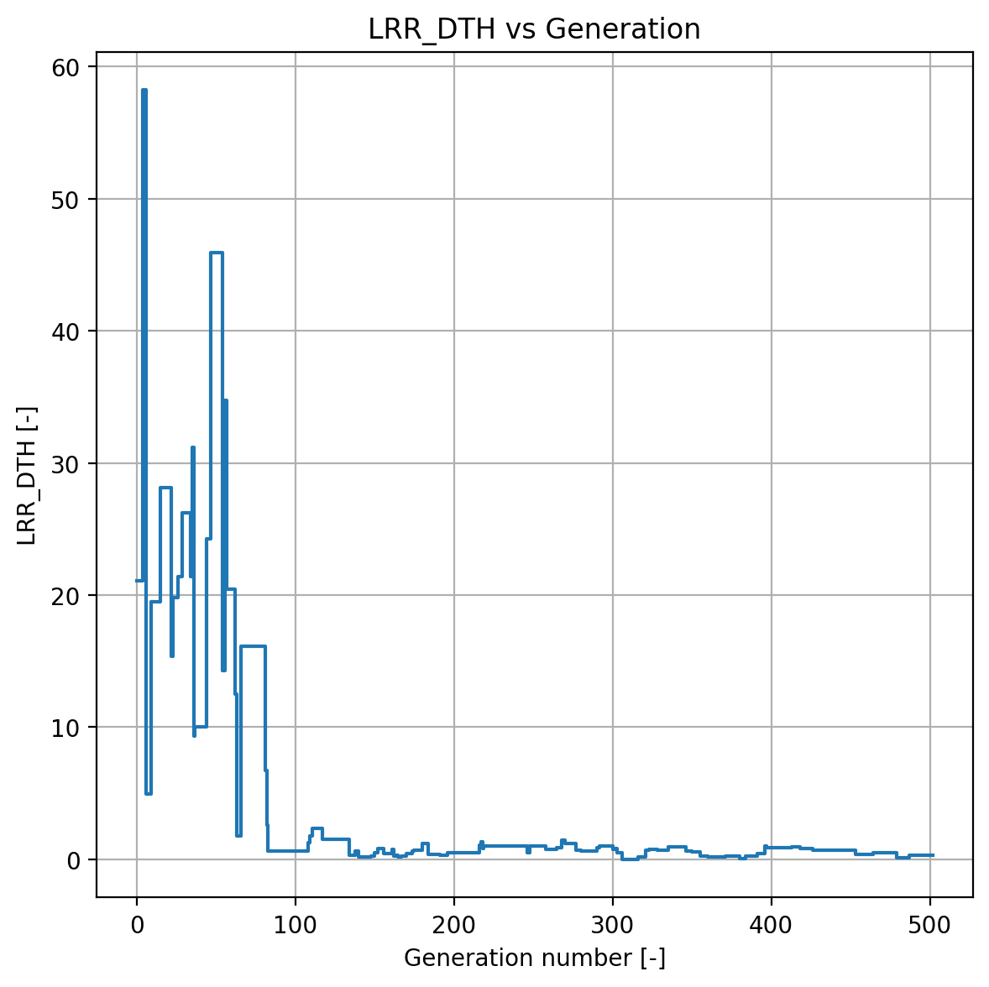
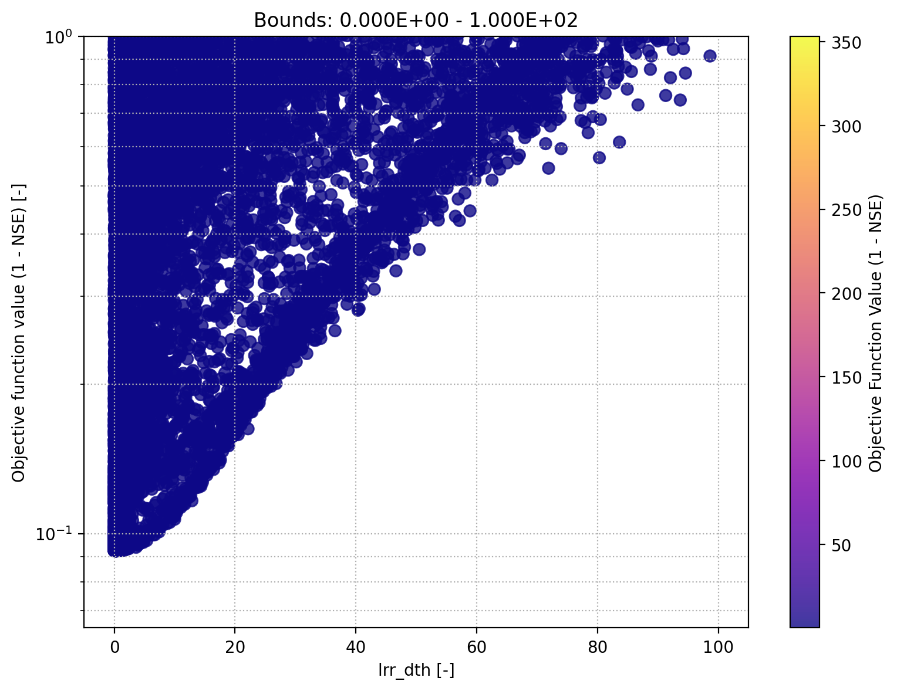
Assignment 1: Parameter Optimization
Lower Reservoir Module – LRR_DTH
The Lower Reservoir Depth gives the max. storage capacity
Convergence Plot
Scatter Plot
Internal Variables

Slide 16
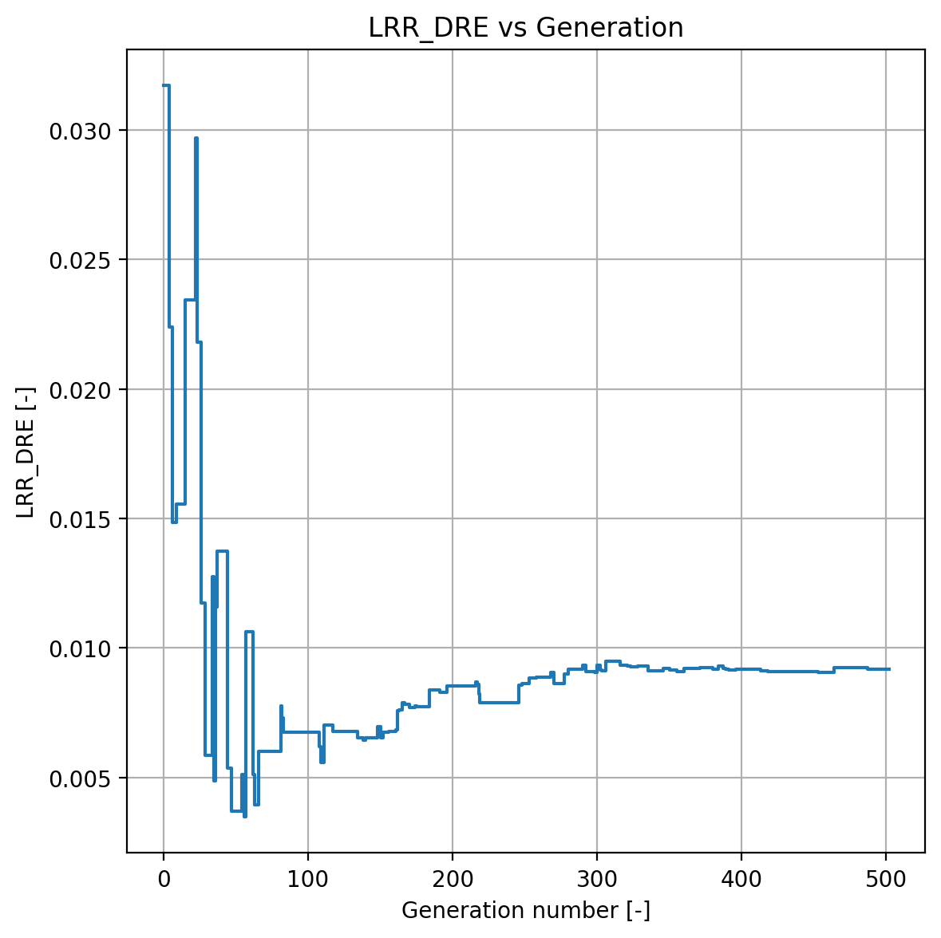
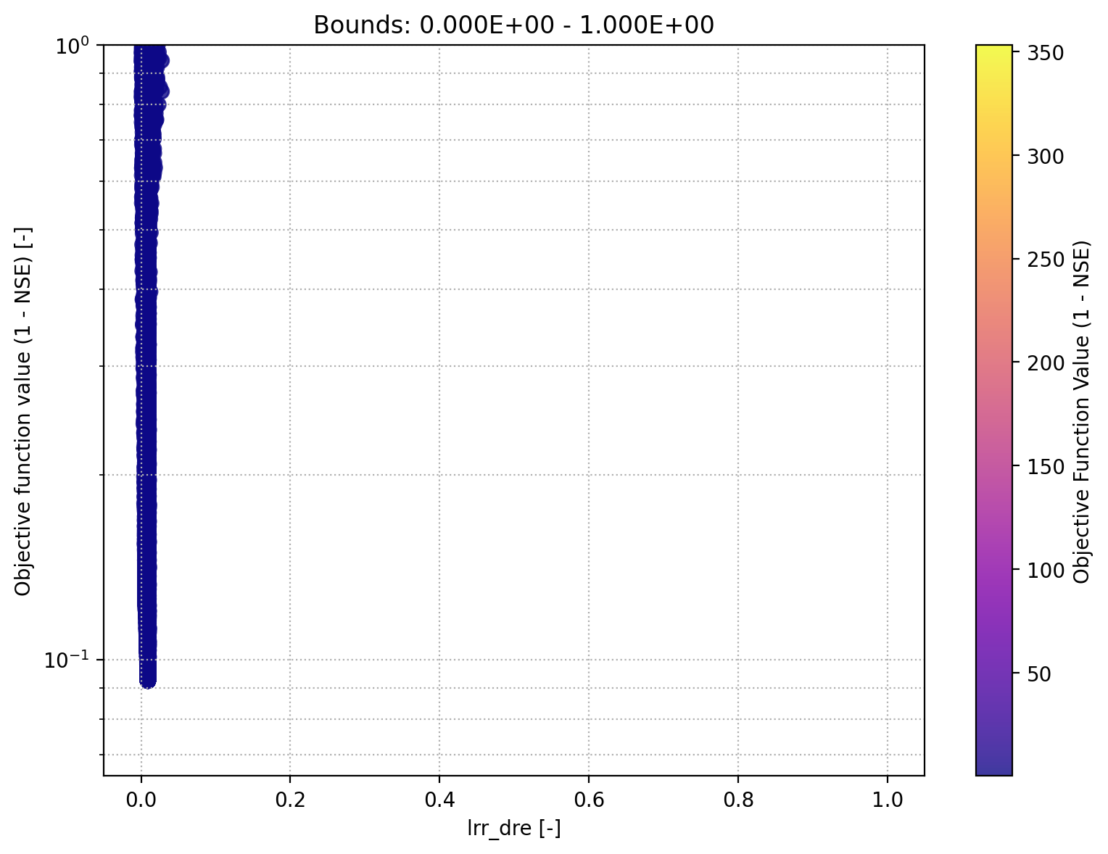
Assignment 1: Parameter Optimization
Lower Reservoir Module – LRR_DRE
The Lower Reservoir Discharge Efficieny factor is the fraction of water that discharges as slow baseflow
Convergence Plot
Scatter Plot
Internal Variables

Slide 17
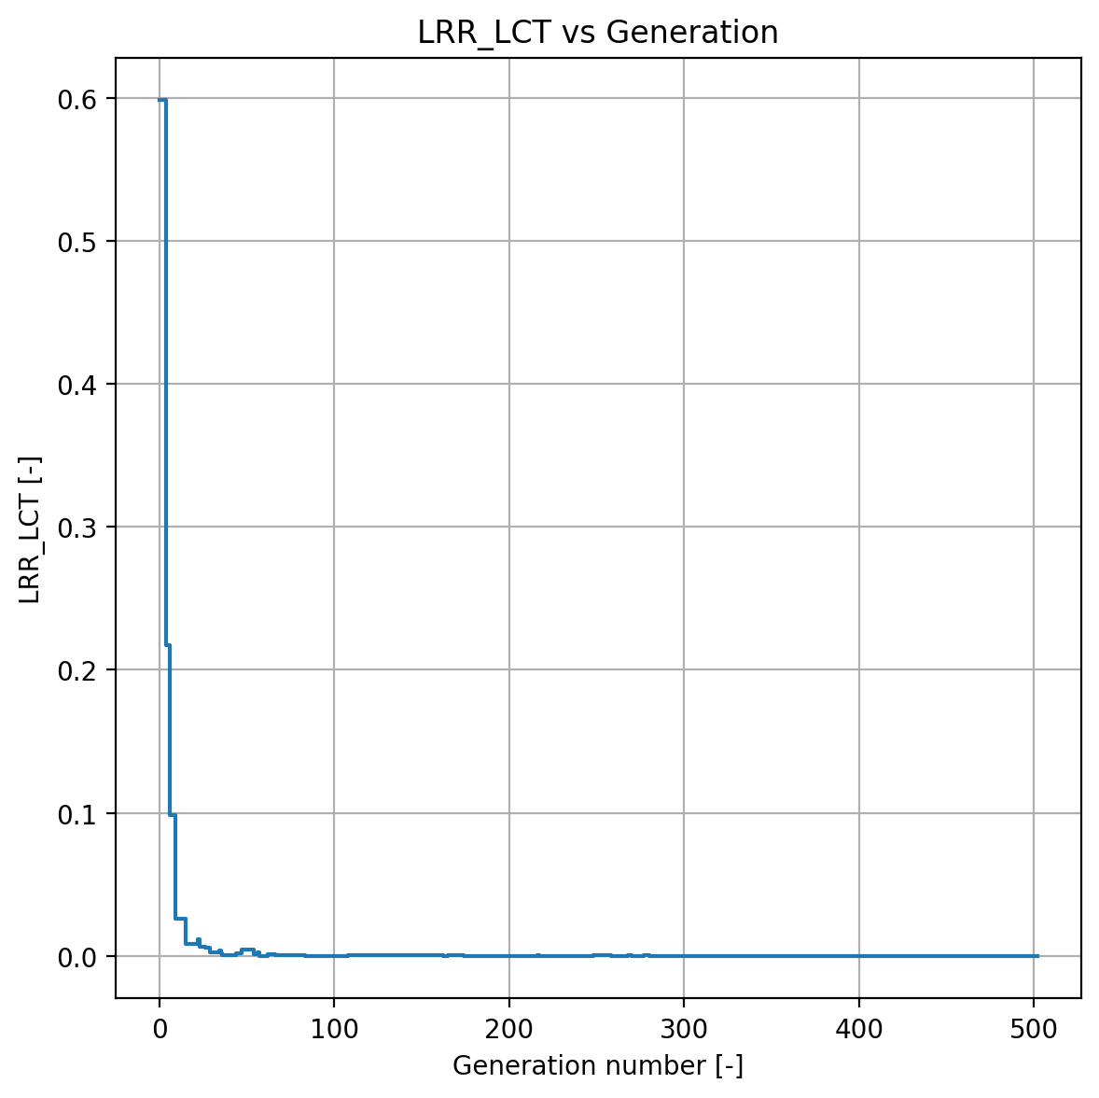
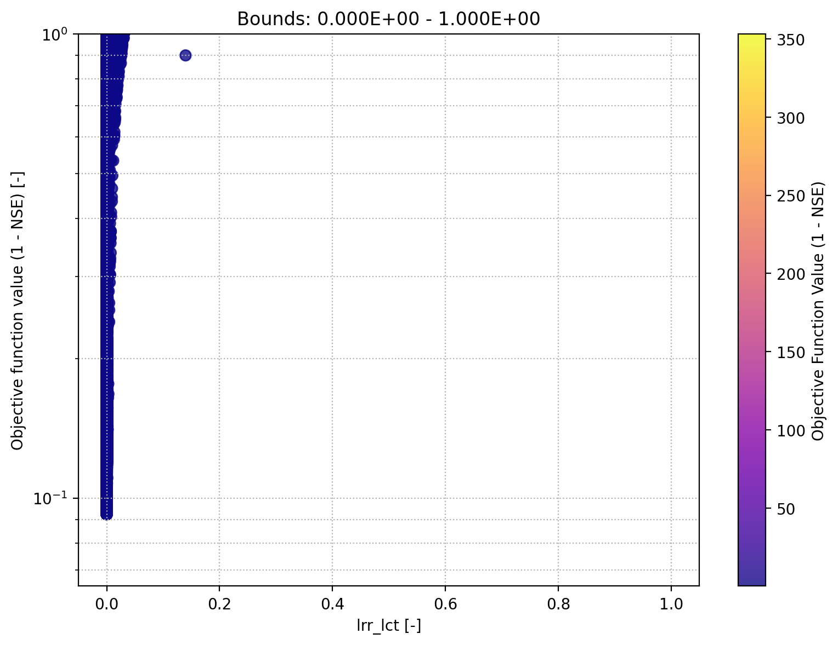
Assignment 1: Parameter Optimization
Lower Reservoir Module – LRR_LCT
The Lower Reservoir Cell Transfer Coef. is the fraction of water released in each step (cannot see it)
Convergence Plot
Scatter Plot
Internal Variables

Slide 18
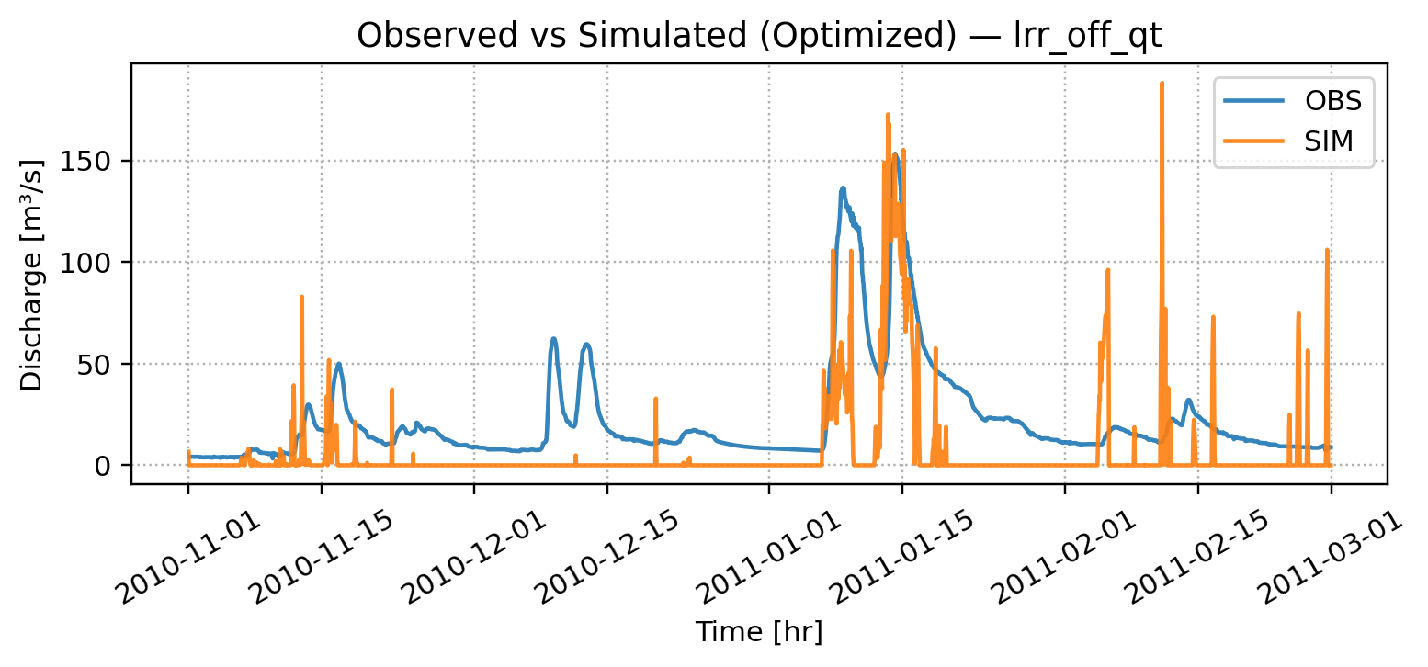
Assignment 1: Parameter Optimization
Turning the Lower Reservoir off
NSE: -0.1039
𝑄𝐿 = 𝐿𝑅𝑅_𝐷𝑇𝐻 × 𝐷𝑅𝐸 DRE = 0, ULC = 0, TDR = 1 (from the upper reservoir)
𝐿𝑅𝑅_𝐷𝑇𝐻 = 𝐿𝑅𝑅_𝐷𝑇𝐻 − 𝑄𝐿
𝐿𝑅𝑅_𝐷𝑇𝐻 = 𝐿𝑅𝑅_𝐷𝑇𝐻 + 𝑃𝐿𝑁

Slide 19
Assignment 1: Parameter Optimization
Conclusion and Reflexion
Problems which had to be overcome
Understand exactly how Differential Evolution works to find the „optimal“ parameter
Adapt the initial code to improve convergence
Implement a gradient based optimizer
Make sense of the NSE and which values do make sense and which not
Use of log scales
Understand the model and the given data (internal variables and geographical catchment in a lumped model)
Conclusion for the next task
Not all parameters seem to contribute the same
In our catchment, Lower Reservoir Module seems to play the most important role
With our implementation, we obtain a descend NSE and simulation.
Sensitivity Analysis useful

Slide 20
Assignment 2: Local Sensitivity Analysis

Slide 21
Assignment 2: Local Sensitivity Analysis
Preconsiderations
Investigating the local sensitivity of the parameters
Assignment 1: Found 18 optimal parameters (hopefully)
Assignment 1: URR seems less sensitive, LRR and SNOW more
First Verification of our results using local sensitivity analysis
Dimension reduction, only one parameter is varied
Expectation: Obtain parabolic OFV plot if parameter is sensitivity in the local sense
Gut feeling: Not good to vary 1 parameter in 18 dimensions

Slide 22
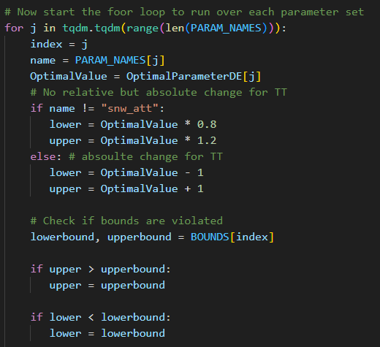
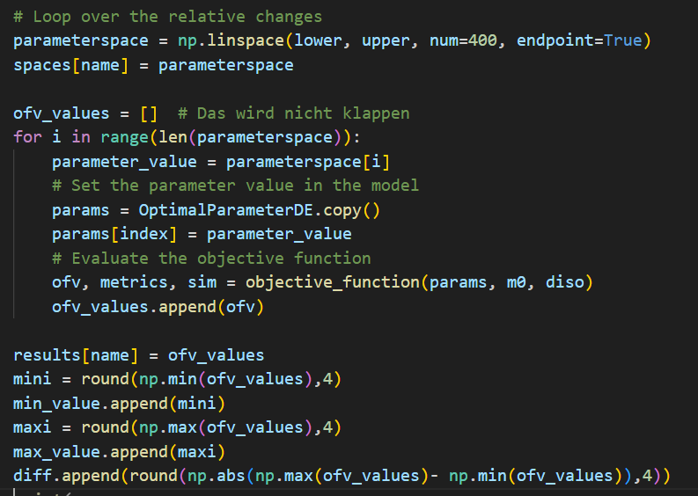
Assignment 2: Local Sensitivity Analysis
Implementation

Slide 23
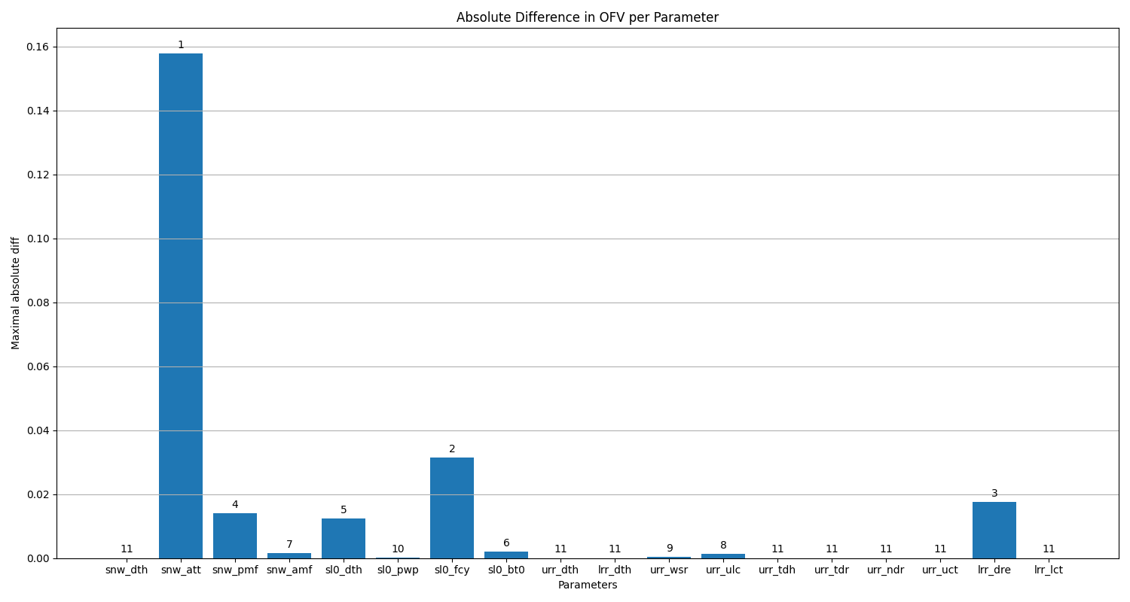
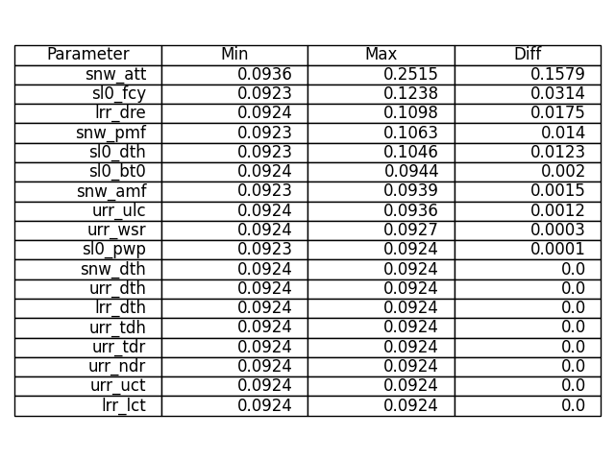
Assignemnt 2: Local Sensitivity Analysis
Result – 20% deviation

Slide 24
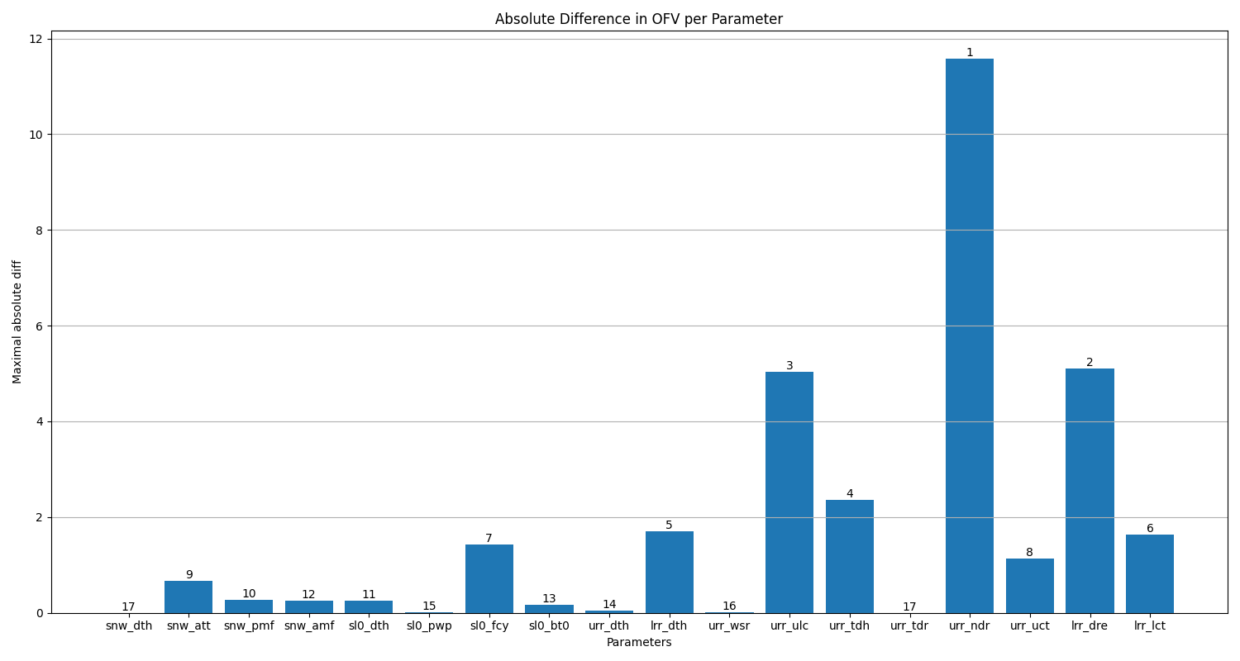
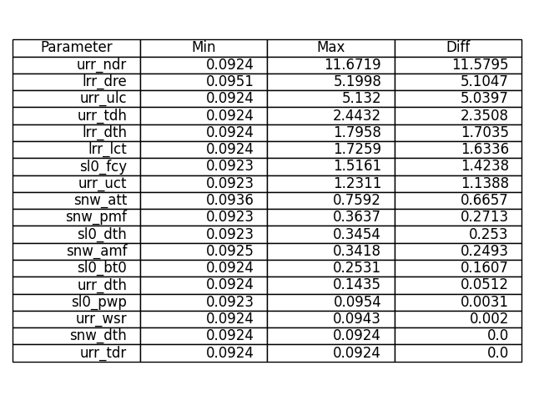
Assignement 2: Local Sensitivity Analysis
Result – whole boundaries

Slide 25
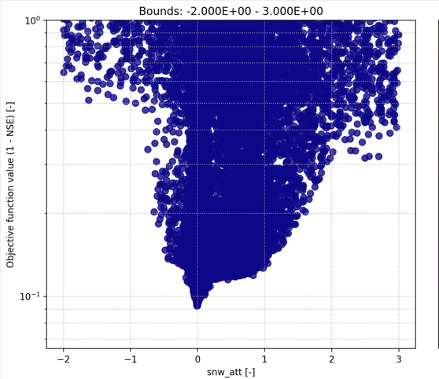
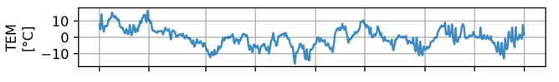
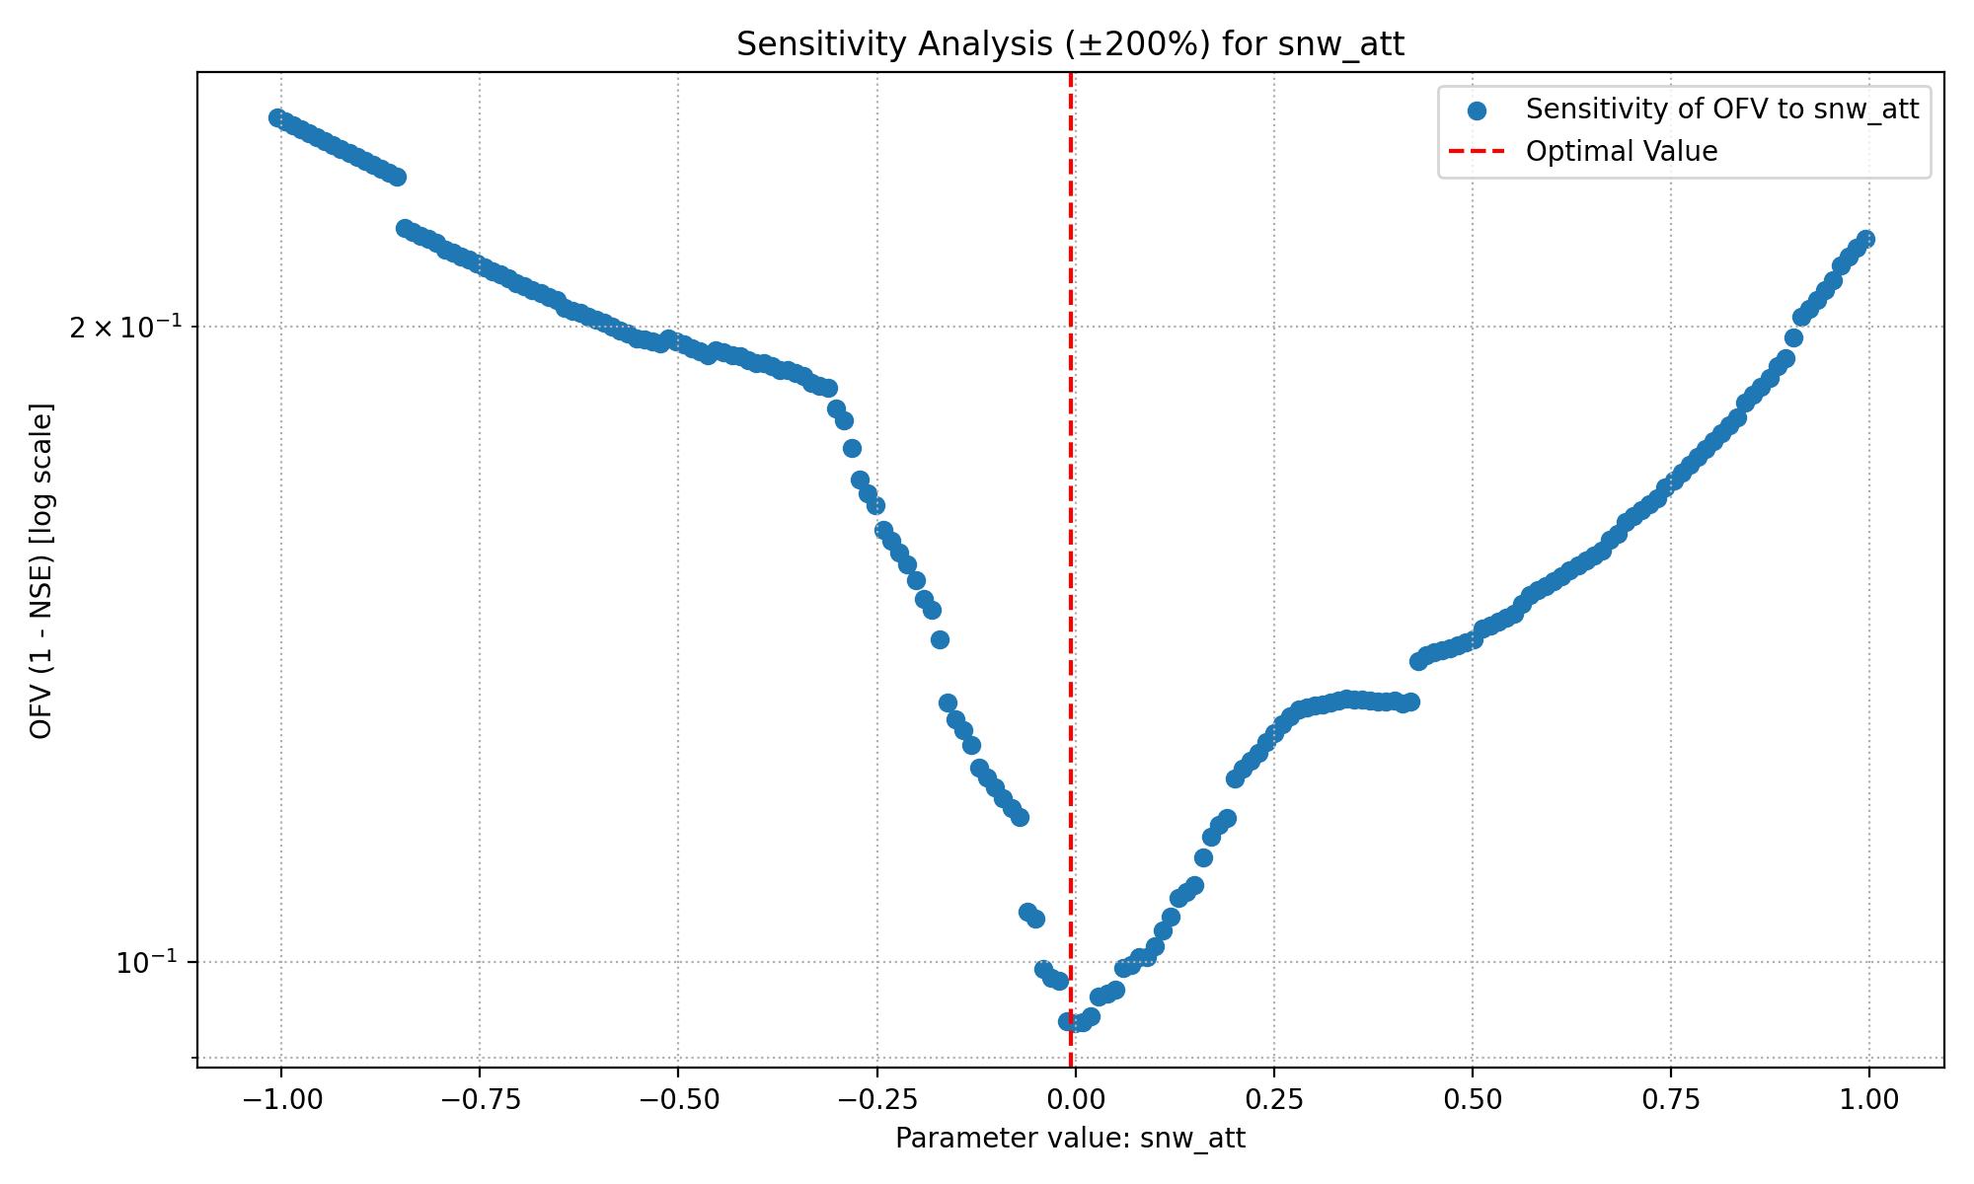
Assignment 2: Local Sensitivity Analysis
Snow Fall/Melt Temperature Threshold

Slide 26
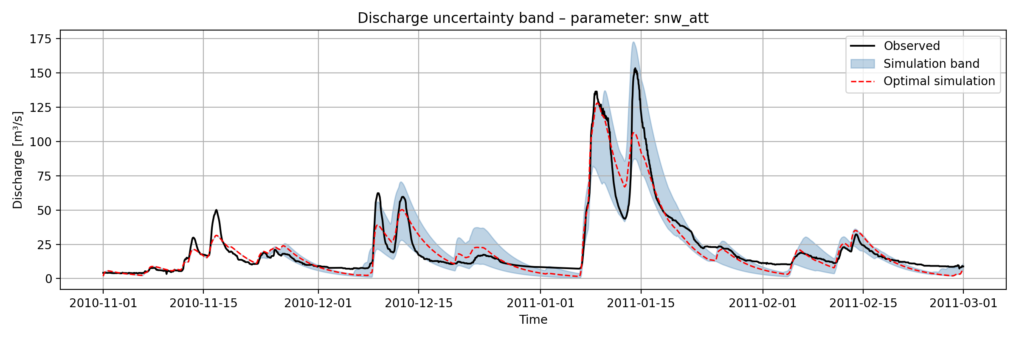
Assignment 2: Local Sensitivity Analysis
Snow Fall/Melt Temperature Threshold
Credits to Group C

Slide 27
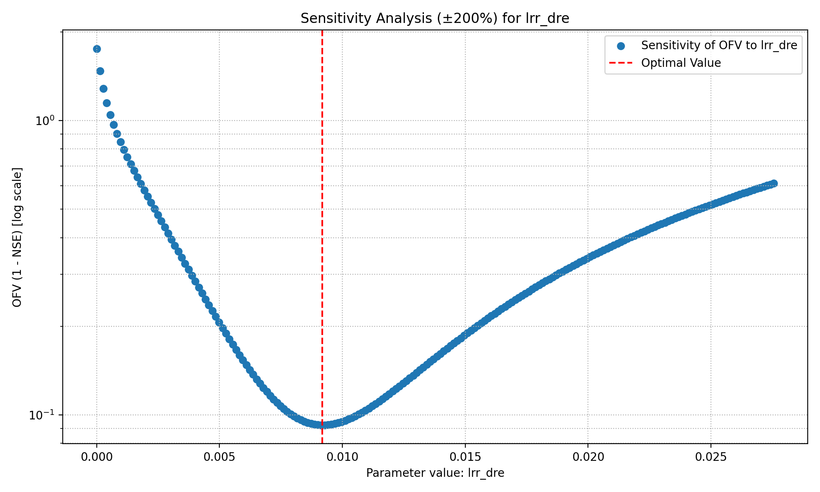



Assignment 2: Local Sensitivity Analysis
Discharge Rate

Slide 28

Assignment 2: Local Sensitivity Analysis
Discharge Rate

Slide 29



Assignment 2 : Local Sensitivity Analysis
Precipitation Melt Factor

Slide 30

Assignment 2 : Local Sensitivity Analysis
Precipitation Melt Factor

Slide 31


Trying to make a sensitive parameter not sensitive
Precipitation Melt Factor (PMF)
Describes the amount of snow melt induced by precipitation (if it rains, snow melts faster)
We still want to account for the effect that precipitation in form of rain increases melt
Suggestion:
$$PMF= \frac{PPT}{SNW_{DTH}+ε}$$
PMF does not play a role anymore
If PPT small but SNW_DTH high => less contribution to MELT
If PPT high(low) and SNW_DTH high(low) , i.e. the same => will be around 1, i.e. PPT does not melt whole snow instantely (PPT does not affect the melt much)
If PPT high and SNW_DTH small => faster melt (think of muddy snow in February/March)
If SNW_DTH = 0 no devision by zero and later on MIN(MLT,SNW_DTH) = SNW_DTH

Slide 32



Trying to make a sensitive parameter not sensitive
Precipitation Melt Factor (PMF) (20 % deviation)
With rewritten PMF
Without rewritten PMF

Slide 33




Assignment 2 : Local Sensitivity Analysis
Soil Field Capacity

Slide 34

Assignment 2 : Local Sensitivity Analysis
Soil Field Capacity

Slide 35




Assignment 2 :Local Sensitivity Analysis
Soil Depth

Slide 36

Assignment 2 :Local Sensitivity Analysis
Soil Depth

Slide 37



Assignment 2 : Local Sensitivity Analysis
Soil Beta
Idea to make it less sensitive:
-linearization, e.g. apply natural logarithm

Slide 38




Assignement 2: Local Sensitivity Analysis
Percolation Coefficient Upper To Lower

Slide 39




Assignemnt 2: Local Sensitivity Analysis
Upper Reservoir Threshold Depth

Slide 40
Assignment 2: Local Sensitivity Analysis
Conclusion and Reflexion
Problems which had to be overcome
Understand shortcomings of local sensitivity analysis
Understand the importance of bounds
Beaware of the nature of the parameter (e.g. SNW_ATT)
Try to fit the big picture
Conclusion for the next task
Assignment 1 observations were verified
URR not locally sensitive
LRR parameters the most sensitive
Soil could be rewritten, in general: It is possible to rewrite the model
Internal variables and time series contributes a lot in the sensitivity
Still missing the big picture: Varying all parameters to determine sensitvity (Global)

Slide 41
Assignment 3: Global Sensitivity Analysis

Slide 42
Assignment 3: Global Sensitivity Analysis
Preconsiderations
Investigating the global sensitivity of the parameters
Assignment 1: Optimiziation to find best parameters
Assignment 2: Local sensitivity anlysis (shortcomings)
Goal: Determining global sensitivity, i.e. how much variation in all input parameters affect the variability of the model output
Sobol indices

Slide 43


Assignment 3: Global Sensitivity Analysis
Paper Satelli et al. – theoretical background
Model setup: $Y=f\left(X_{1},.. , X_{d}\right)$where $f$ is our objective function and $Y$ OFV
Base: Variance based methods using MC
Core idea: Hoeffeding decomposition: $f=f_{0}+ \sum_{i}{f_{i}}+ \sum_{i}{\sum_{j>i}{f_{ij}+ …+ f_{12…d}}}$
Here:
Radial sampling: $\begin{matrix}a_{1,1} & a_{1,2} & a_{1,3} \\ b_{1,1} & a_{1,2} & … \\ a_{1,1} & b_{1,2} & …\end{matrix}\begin{matrix}… & a_{1,k} \\ .. & a_{1,k} \\ .. & a_{1,k}\end{matrix}$
Two approximation (Jansen)
$$S_{i}= \frac{V_{X_{i}}(E_{X_{i}}\left(Y | X_{i}\right))}{V(Y)}$$

Slide 44



Assignment 3: Global Sensitivity Analysis
Setup Code

Slide 45


Assignemnt 3: Global Sensitivity Analysis
Sobol Sampling

Slide 46

Assignment 3: Global Sensitivity Analysis
Sobol Sampling

Slide 47
Global Sensitivity Analysis
Sobol Sampling
Just the draft
Parameter | S1_Full_NSE | ST_Full_NSE | S1_Full_LnNSE | ST_Full_LnNSE | S1_Narrow_NSE | ST_Narrow_NSE | S1_Narrow_LnNSE | ST_Narrow_LnNSE
snw_dth | 0.0108 | 0.0 | 0.0075 | 0.0 | 0.0 | 0.0 | 0.0006 | 0.0
snw_att | 0.0113 | 0.002 | 0.4568 | 0.4642 | 0.0 | 0.0 | 0.0006 | 0.0
snw_pmf | 0.0108 | 0.0 | 0.0076 | 0.0 | 0.0964 | 0.1563 | 0.0006 | 0.0005
snw_amf | 0.0106 | 0.0006 | 0.0078 | 0.0006 | 0.0027 | 0.0508 | 0.0028 | 0.0028
sl0_dth | 0.011 | 0.0004 | 0.0286 | 0.0275 | 0.0263 | 0.2996 | 0.0022 | 0.0209
sl0_pwp | 0.0108 | 0.0 | 0.0076 | 0.0002 | 0.0 | 0.0003 | 0.0006 | 0.0
sl0_fcy | 0.0141 | 0.0042 | 0.0925 | 0.1345 | 0.1948 | 0.5856 | 0.0147 | 0.0344
sl0_bt0 | 0.0112 | 0.001 | 0.141 | 0.1865 | 0.0025 | 0.0139 | 0.0005 | 0.0043
urr_dth | 0.0408 | 0.026 | 0.0075 | 0.0 | 0.0003 | 0.0003 | 0.0012 | 0.0007
lrr_dth | 0.3807 | 0.5895 | 0.0075 | 0.0 | 0.0001 | 0.0 | 0.0008 | 0.0001
urr_wsr | 0.0108 | 0.0 | 0.0083 | 0.001 | 0.0001 | 0.0003 | 0.0006 | 0.0
urr_ulc | 0.0107 | 0.0042 | 0.0144 | 0.0286 | -0.0011 | 0.0122 | 0.0009 | 0.0003
urr_tdh | 0.0104 | 0.0006 | 0.0076 | 0.0 | 0.0 | 0.0 | 0.0006 | 0.0
urr_tdr | 0.011 | 0.0003 | 0.0076 | 0.0 | 0.0 | 0.0 | 0.0006 | 0.0
urr_ndr | 0.0163 | 0.0103 | 0.0259 | 0.0379 | 0.0 | 0.0 | 0.0006 | 0.0
urr_uct | 0.0108 | 0.0001 | 0.0162 | 0.039 | -0.0 | 0.0 | 0.0006 | 0.0
lrr_dre | 0.3697 | 0.587 | 0.0401 | 0.1082 | 0.1825 | 0.3823 | 0.9566 | 0.9585
lrr_lct | 0.0114 | 0.0018 | 0.0778 | 0.1424 | 0.0 | 0.0 | 0.0007 | 0.0

Slide 48


Assignment 3: Global Sensitivity Analysis
Sobol Sampling
Parameter | S1_Full_NSE | ST_Full_NSE | S1_Full_LnNSE | ST_Full_LnNSE
snw_dth | 0.0108 | 0.0 | 0.0075 | 0.0
snw_att | 0.0113 | 0.002 | 0.4568 | 0.4642
snw_pmf | 0.0108 | 0.0 | 0.0076 | 0.0
snw_amf | 0.0106 | 0.0006 | 0.0078 | 0.0006
sl0_dth | 0.011 | 0.0004 | 0.0286 | 0.0275
sl0_pwp | 0.0108 | 0.0 | 0.0076 | 0.0002
sl0_fcy | 0.0141 | 0.0042 | 0.0925 | 0.1345
sl0_bt0 | 0.0112 | 0.001 | 0.141 | 0.1865
urr_dth | 0.0408 | 0.026 | 0.0075 | 0.0
lrr_dth | 0.3807 | 0.5895 | 0.0075 | 0.0
urr_wsr | 0.0108 | 0.0 | 0.0083 | 0.001
urr_ulc | 0.0107 | 0.0042 | 0.0144 | 0.0286
urr_tdh | 0.0104 | 0.0006 | 0.0076 | 0.0
urr_tdr | 0.011 | 0.0003 | 0.0076 | 0.0
urr_ndr | 0.0163 | 0.0103 | 0.0259 | 0.0379
urr_uct | 0.0108 | 0.0001 | 0.0162 | 0.039
lrr_dre | 0.3697 | 0.587 | 0.0401 | 0.1082
lrr_lct | 0.0114 | 0.0018 | 0.0778 | 0.1424
SUM | 0,9632 | 1,2280 | 0,9623 | 1,1706

Slide 49



Assignment 3: Global Sensitivity Analysis
NSE versus LN-NSE
Nash Sutcliffe Efficiency
Log Nash Sutcliffe Efficiency
Small simulated discharges are enhanced in log
Large flows take less influence
If observation and simulation differs a lot, log amplifies

Slide 50


Global Sensitivity Analysis
Sobol Sampling
Parameter | S1_Narrow_NSE | ST_Narrow_NSE | S1_Narrow_LnNSE | ST_Narrow_LnNSE
snw_dth | 0.0 | 0.0 | 0.0006 | 0.0
snw_att | 0.0 | 0.0 | 0.0006 | 0.0
snw_pmf | 0.0964 | 0.1563 | 0.0006 | 0.0005
snw_amf | 0.0027 | 0.0508 | 0.0028 | 0.0028
sl0_dth | 0.0263 | 0.2996 | 0.0022 | 0.0209
sl0_pwp | 0.0 | 0.0003 | 0.0006 | 0.0
sl0_fcy | 0.1948 | 0.5856 | 0.0147 | 0.0344
sl0_bt0 | 0.0025 | 0.0139 | 0.0005 | 0.0043
urr_dth | 0.0003 | 0.0003 | 0.0012 | 0.0007
lrr_dth | 0.0001 | 0.0 | 0.0008 | 0.0001
urr_wsr | 0.0001 | 0.0003 | 0.0006 | 0.0
urr_ulc | -0.0011 | 0.0122 | 0.0009 | 0.0003
urr_tdh | 0.0 | 0.0 | 0.0006 | 0.0
urr_tdr | 0.0 | 0.0 | 0.0006 | 0.0
urr_ndr | 0.0 | 0.0 | 0.0006 | 0.0
urr_uct | -0.0 | 0.0 | 0.0006 | 0.0
lrr_dre | 0.1825 | 0.3823 | 0.9566 | 0.9585
lrr_lct | 0.0 | 0.0 | 0.0007 | 0.0
SUM | 0,5046 | 1,5016 | 0,9858 | 1,0225

Slide 51

Global Sensitivity Analysis
Sobol Sampling

Slide 52

Global Sensitivity Analysis
Sobol Sampling

Slide 53

Global Sensitivity Analysis
Sobol Sampling

Slide 54
Assignment 3: Gloabl Sensitivity Analysis
Conclusion and Reflexion
Problems which had to be overcome
Understand shortcomings of local sensitivity analysis
Understand the importance of bounds
Beaware of the nature of the parameter (e.g. SNW_ATT)
Try to fit the big picture
Conclusion for the next task
Assignment 1 observations were verified
URR not locally sensitive
LRR parameters the most sensitive
Soil could be rewritten, in general: It is possible to rewrite the model
Internal variables and time series contributes a lot in the sensitivity
Still missing the big picture: Varying all parameters to determine sensitvity (Global)

Slide 55
Big picture: Combining the 3 assignments

Slide 56
COMPARING the result of local and global sensitivity

Slide 57
Interpret everything, take e.g. 6 parameter and put everything together
Explain the differences in ln NSE and NSE

